Slide 1
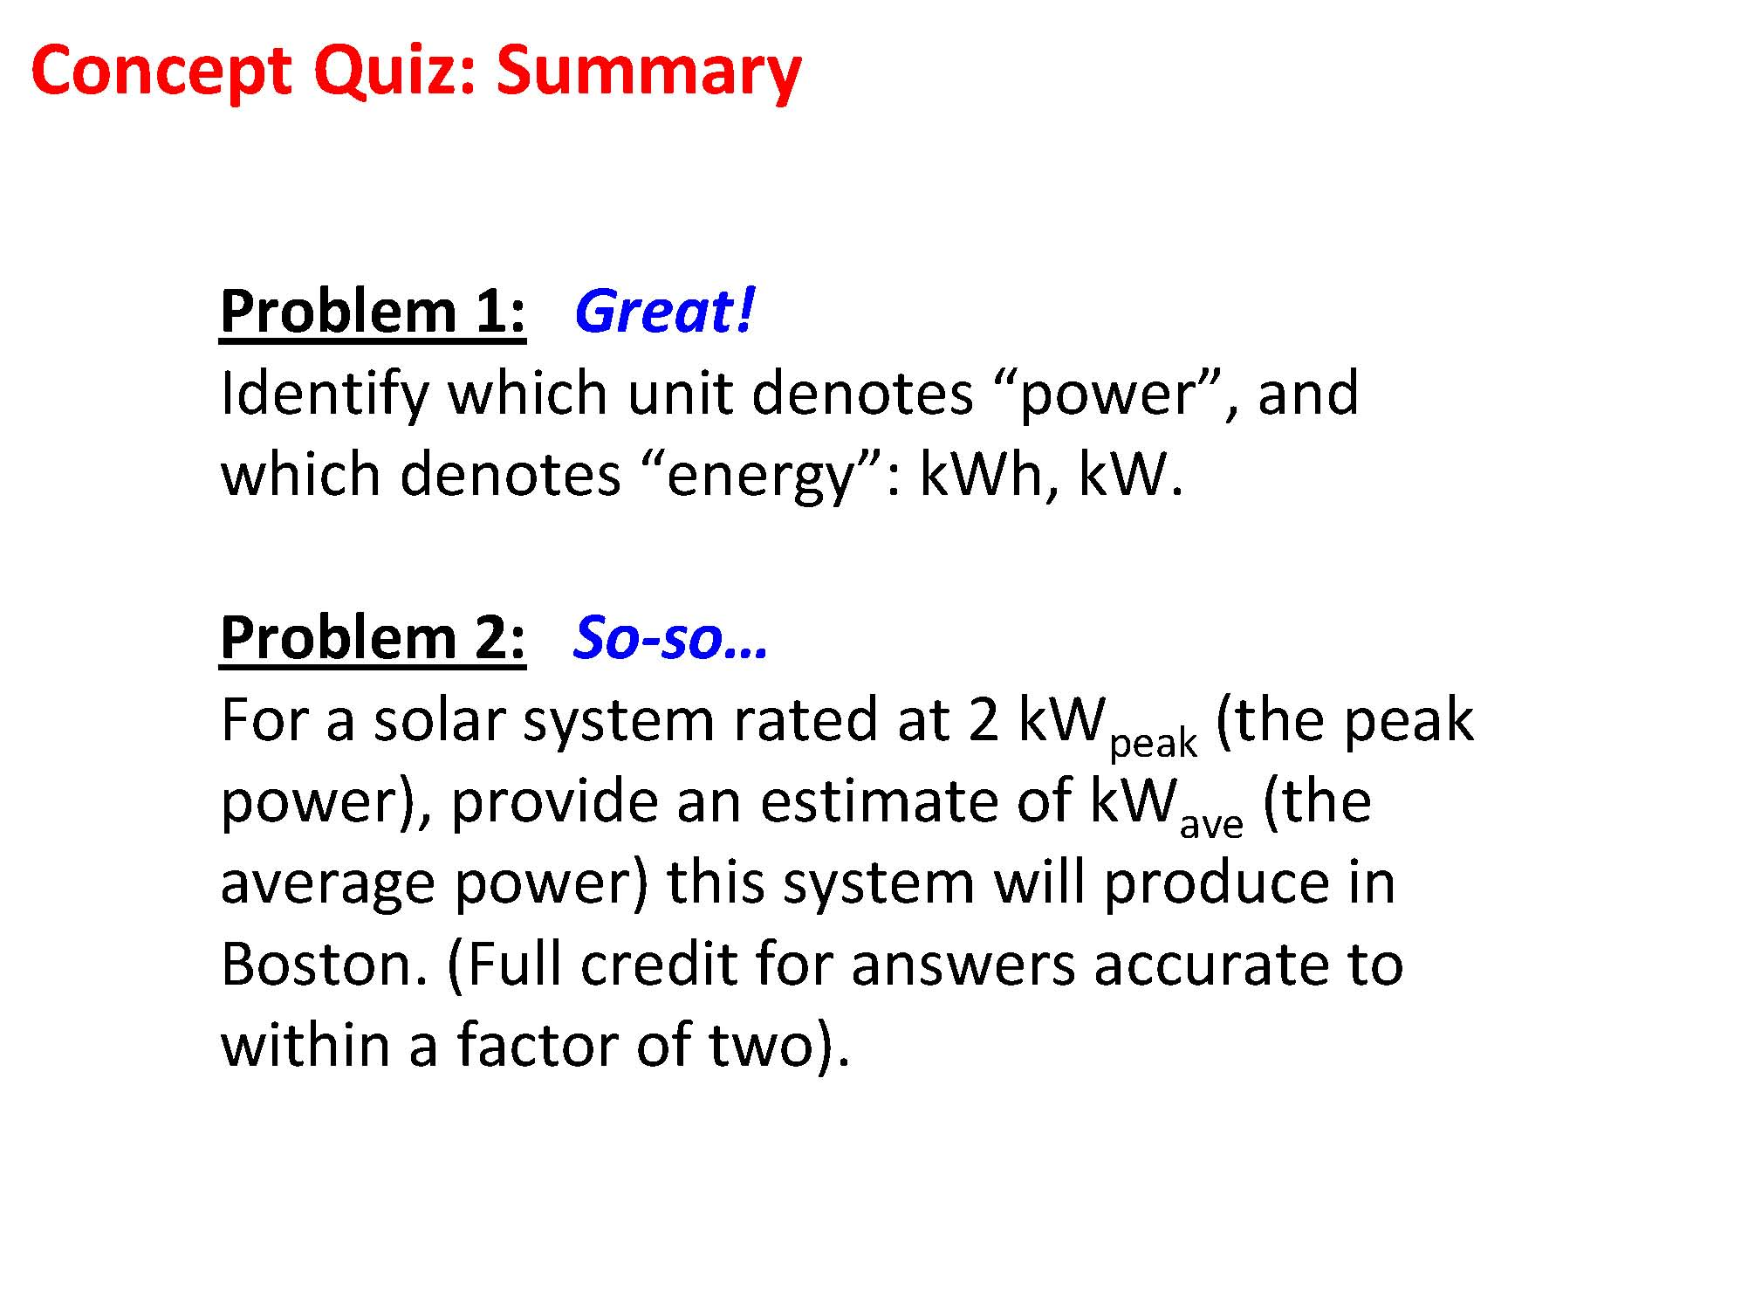

Slide 2
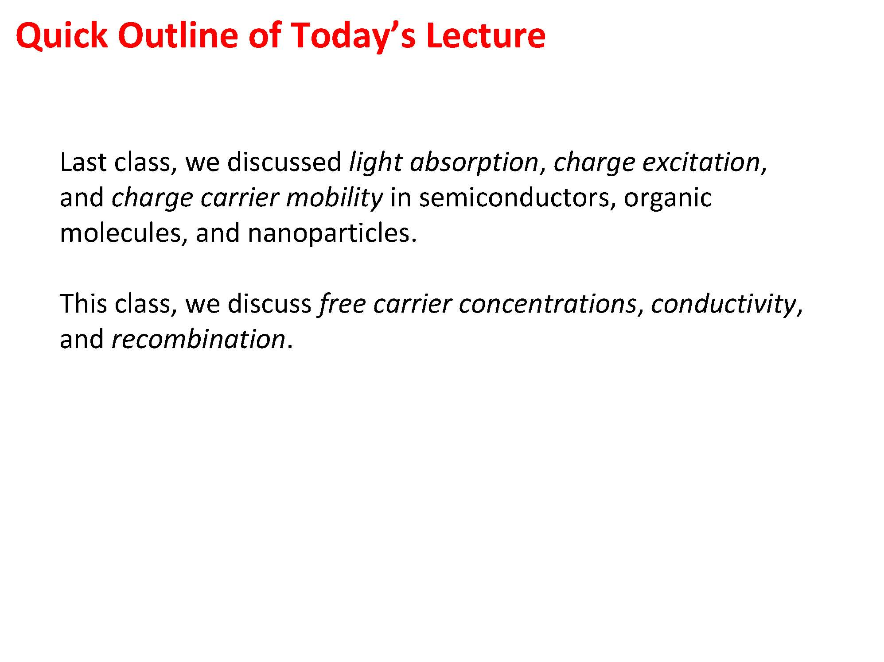

Slide 3
Outline
Review Material Properties
Band gap
Absorption Coefficient
Mobility

Slide 4
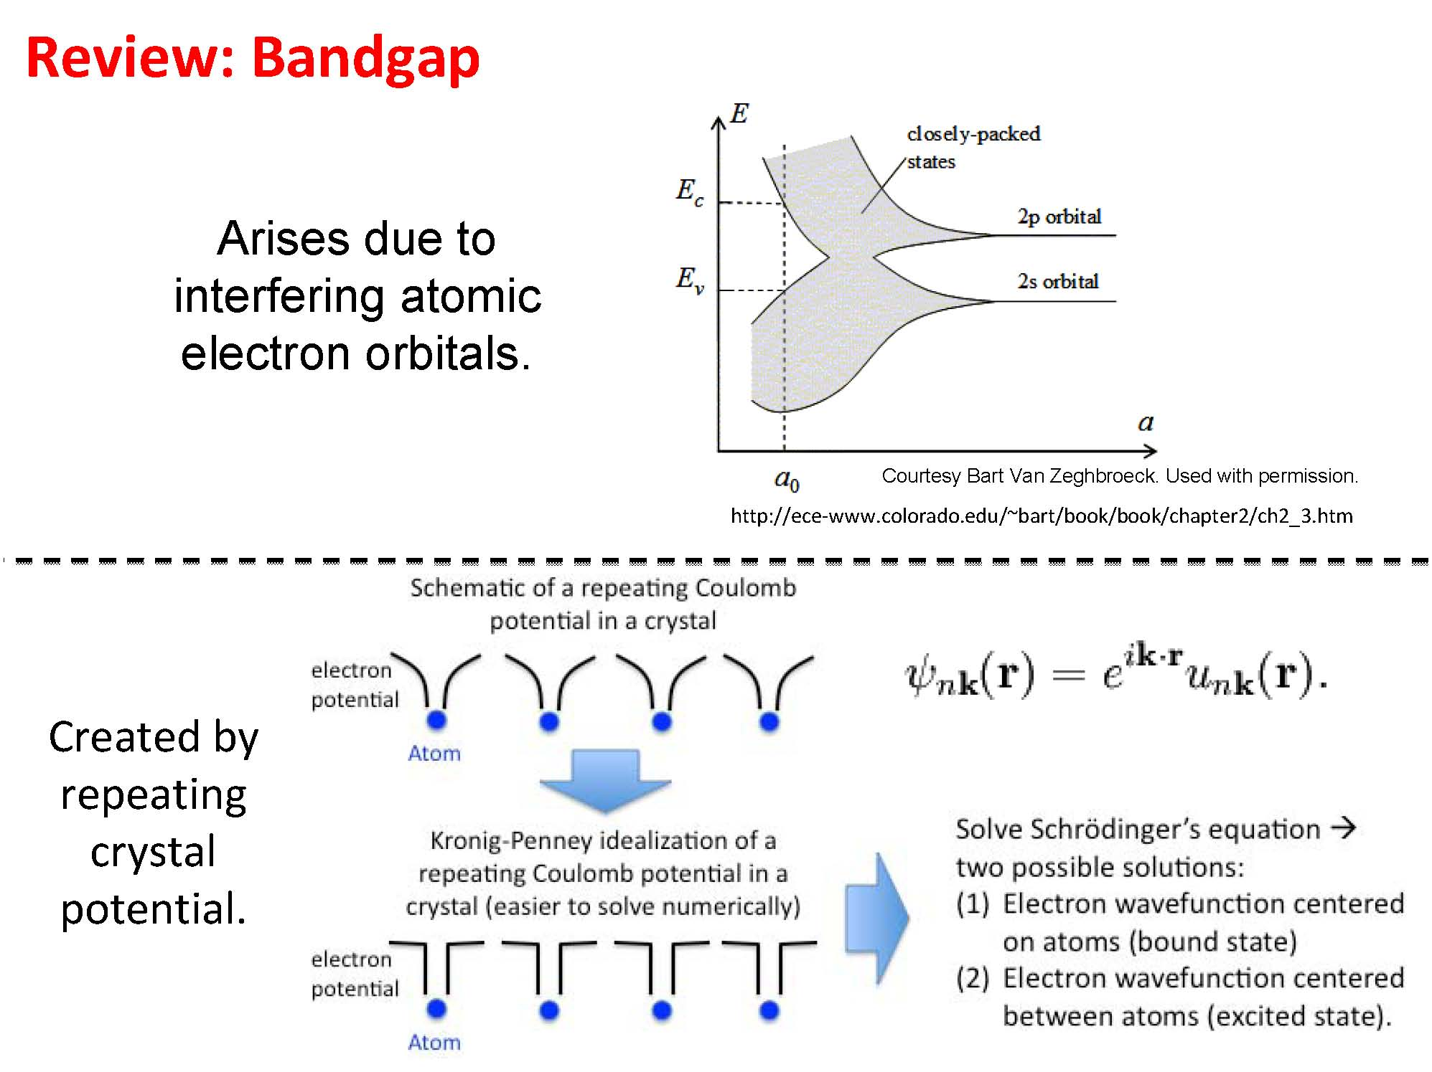

Slide 5
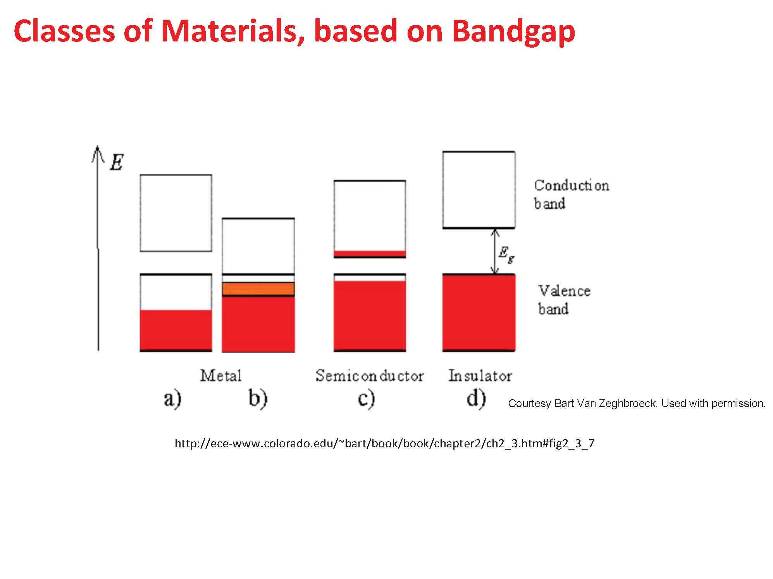

Slide 6
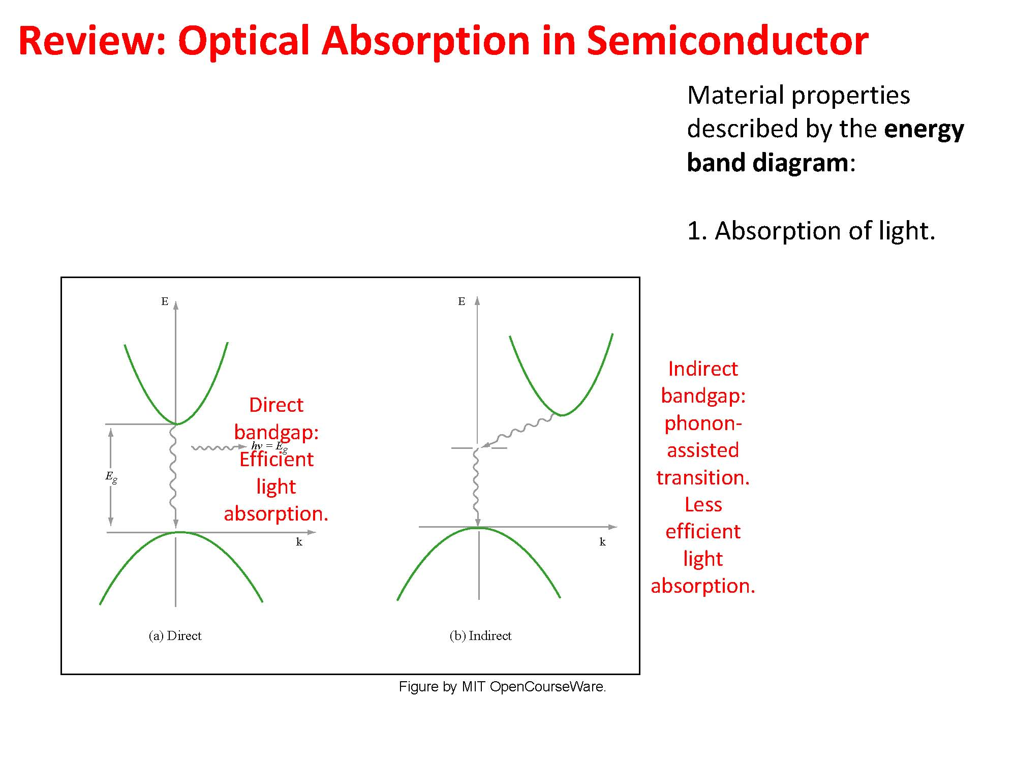

Slide 7
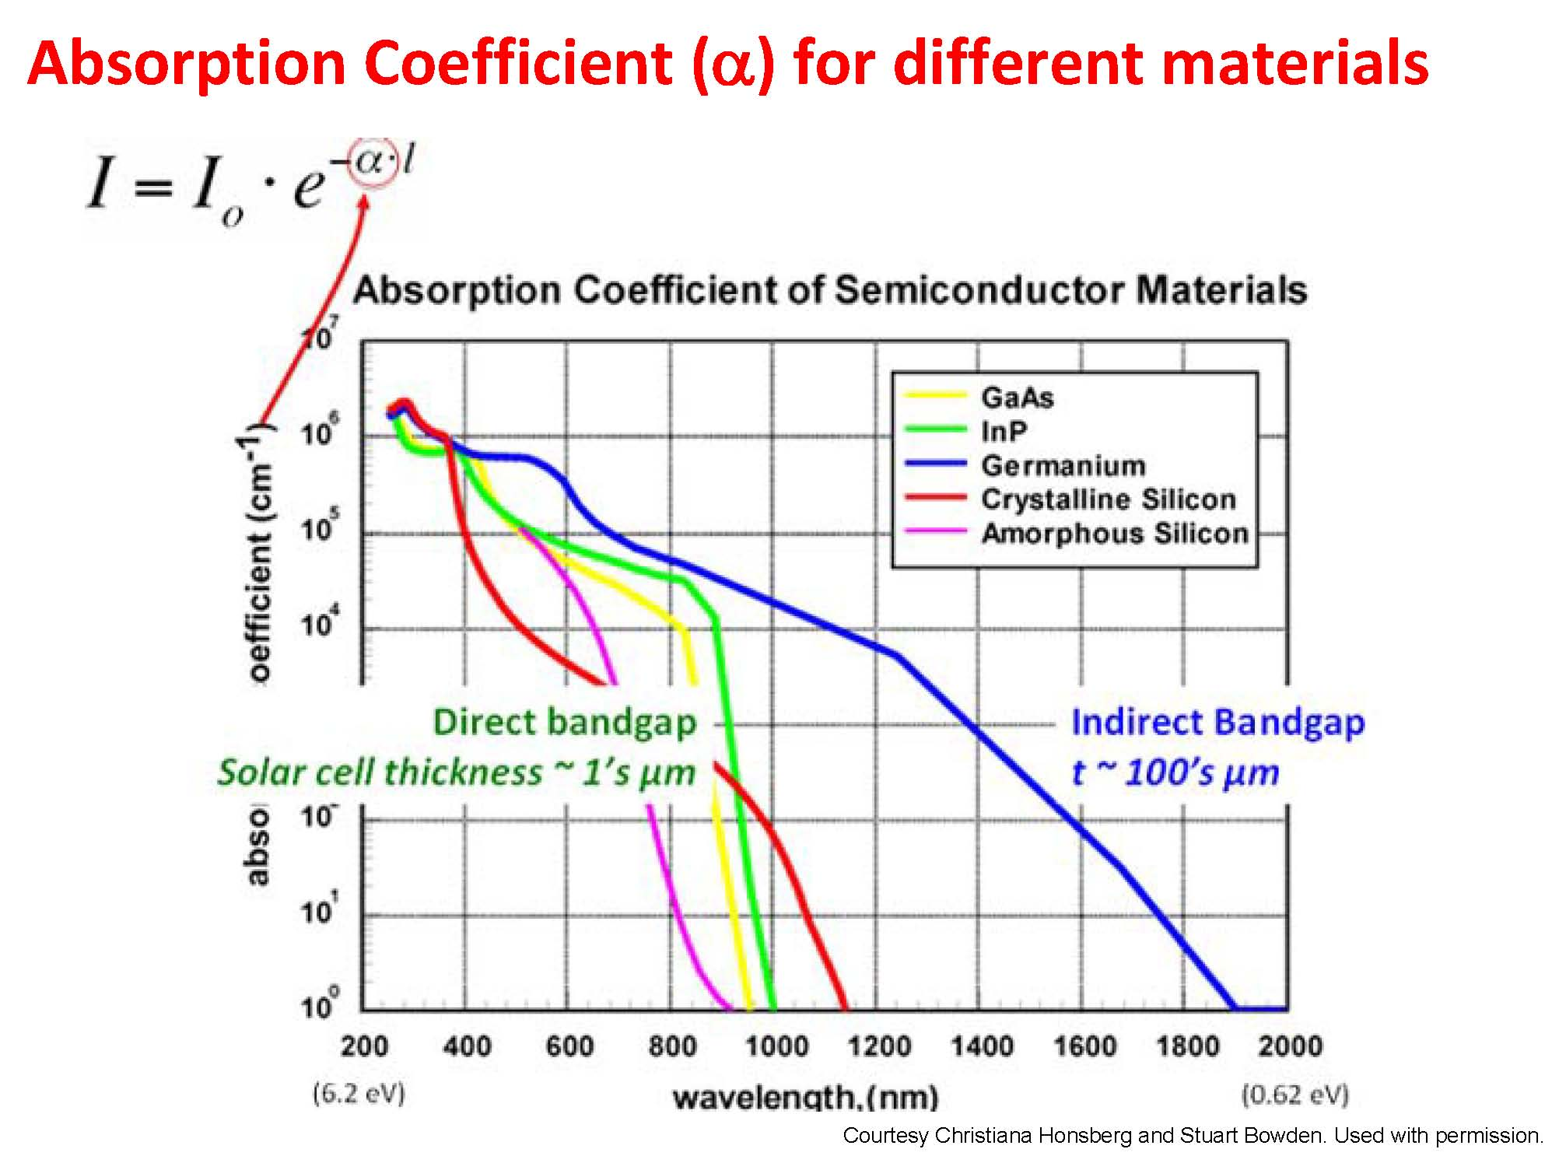

Slide 8
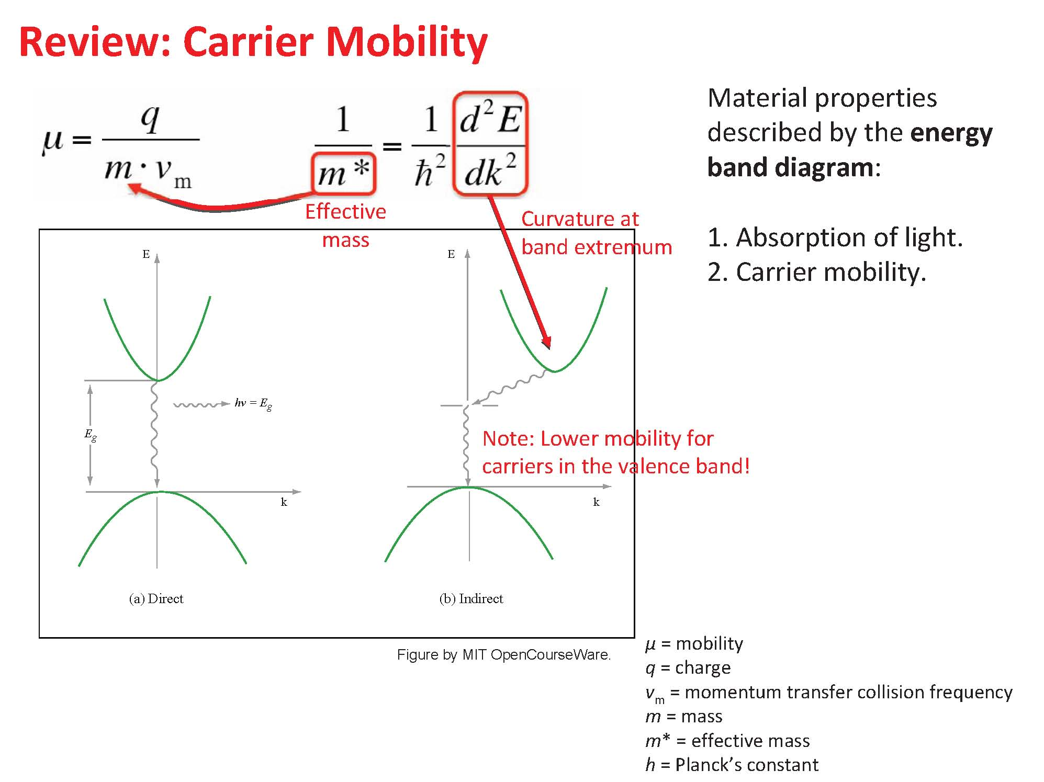

Slide 10
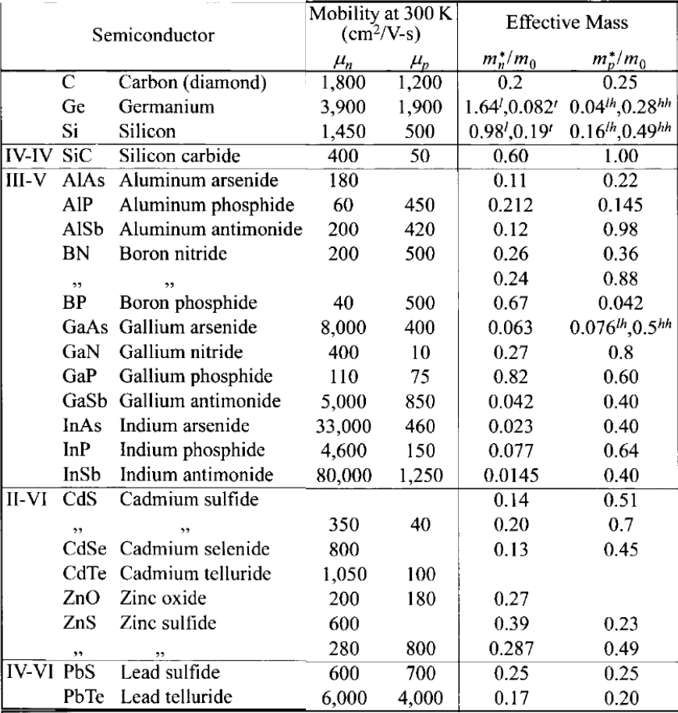

Slide 11
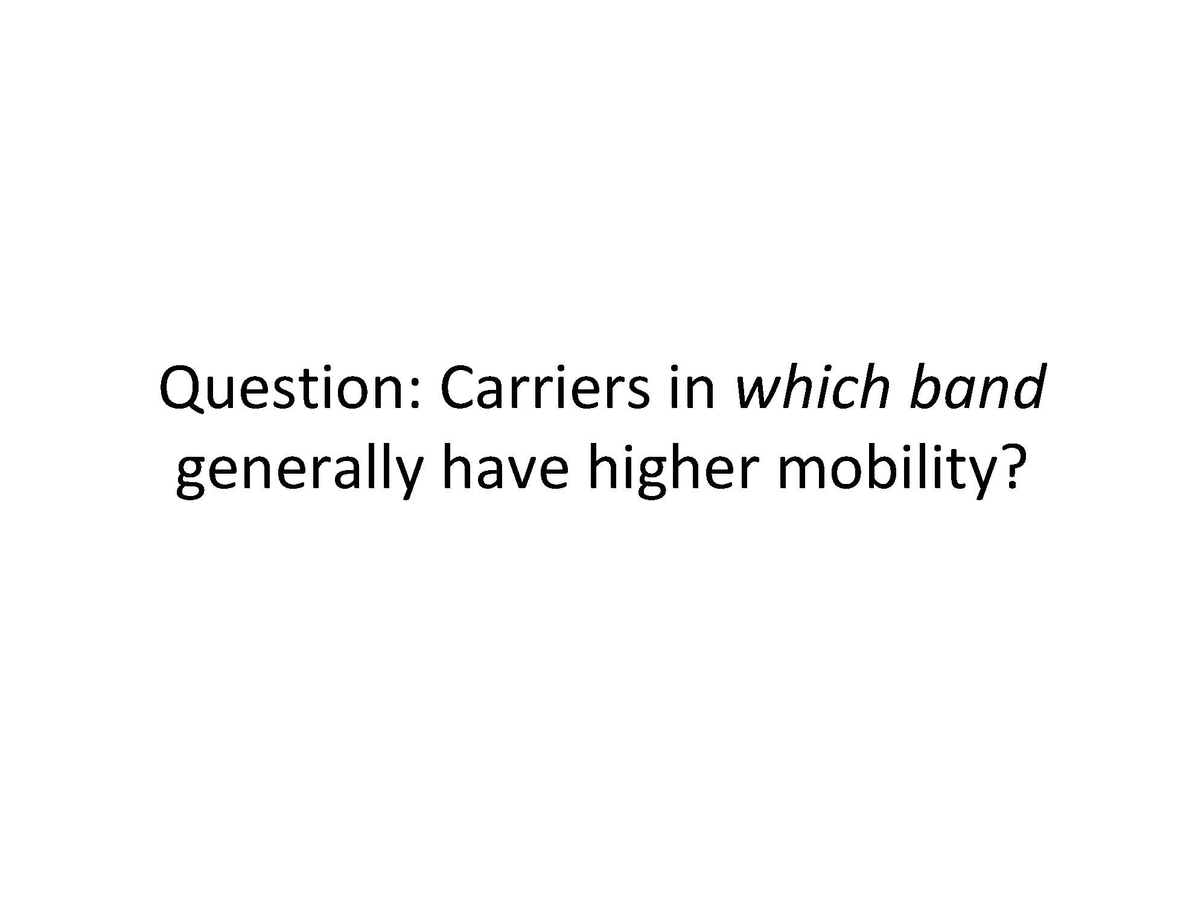

Slide 12
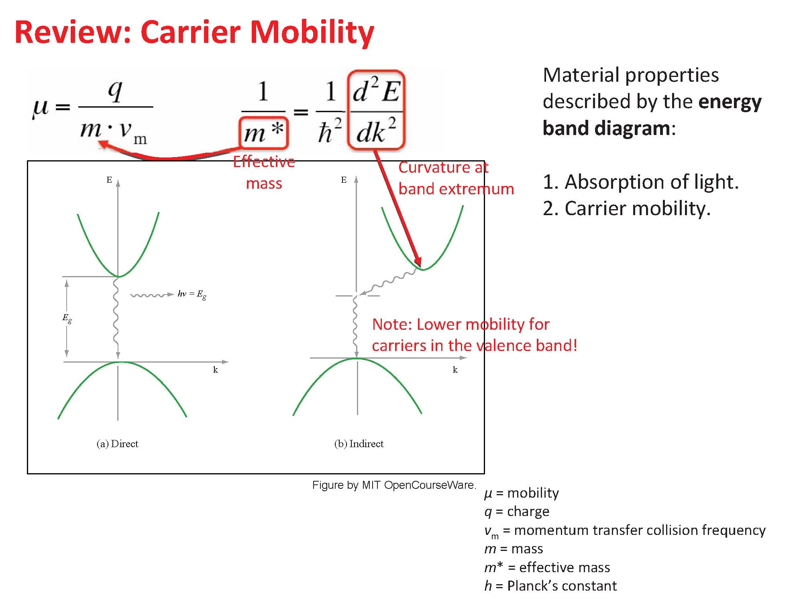

Slide 13
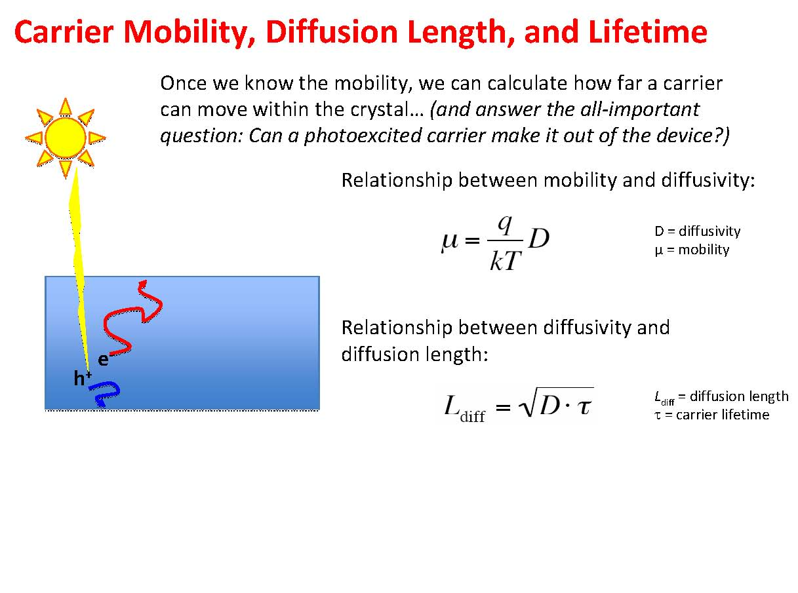

Slide 14
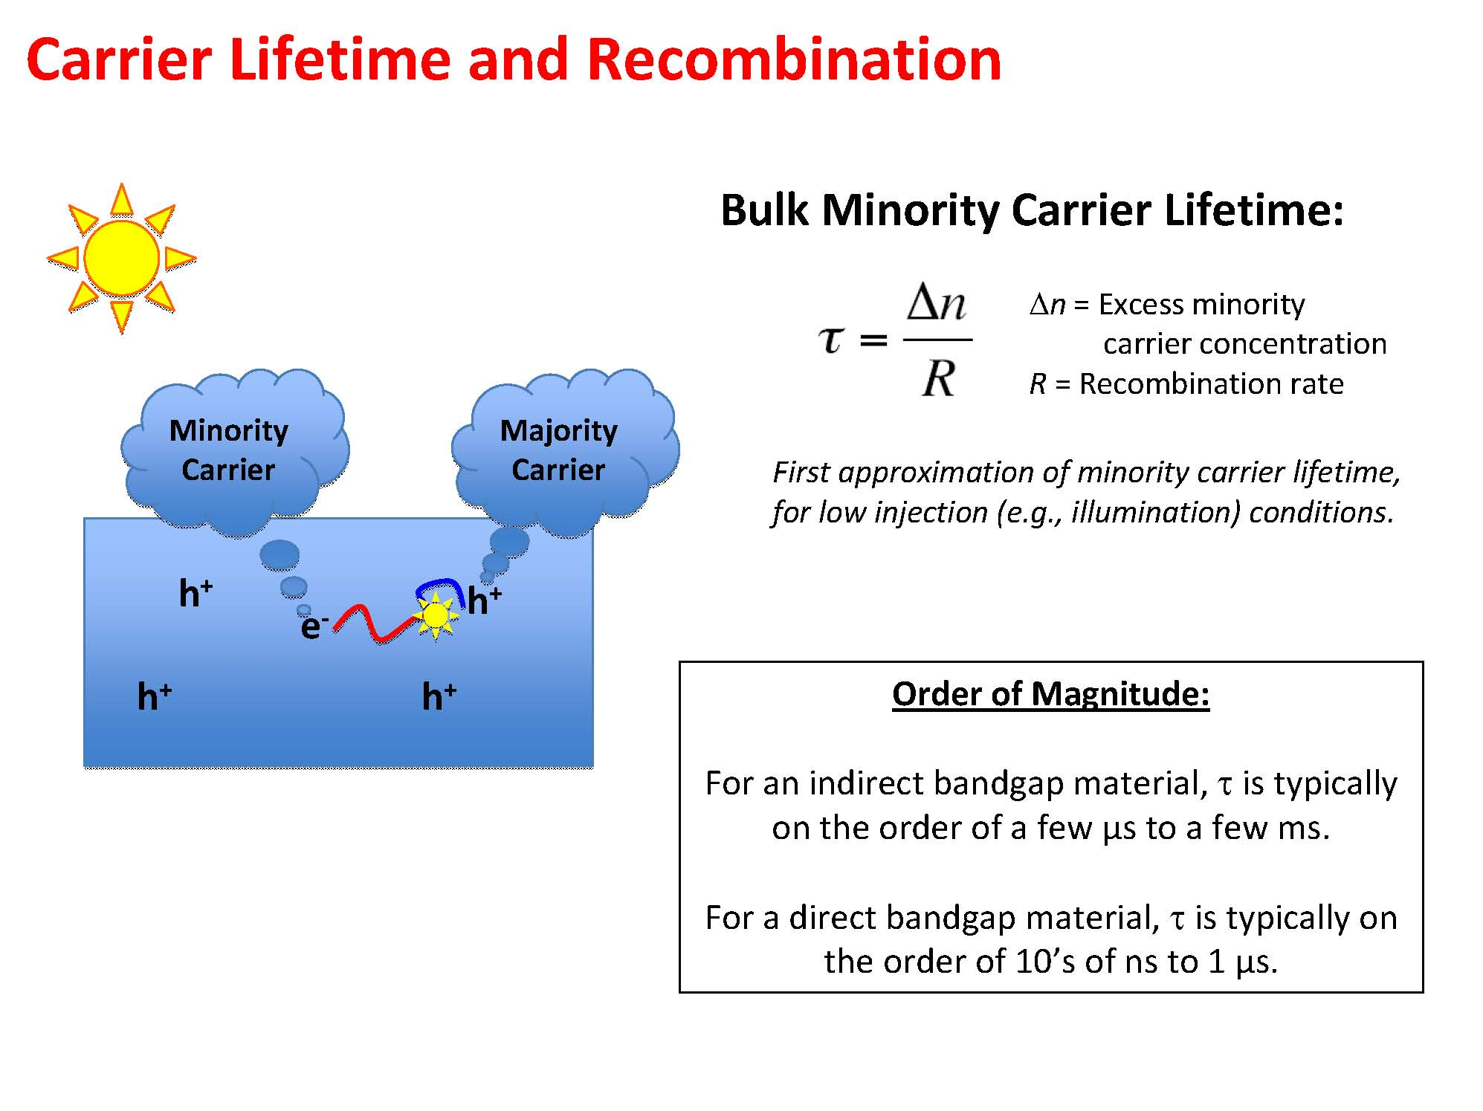

Slide 15
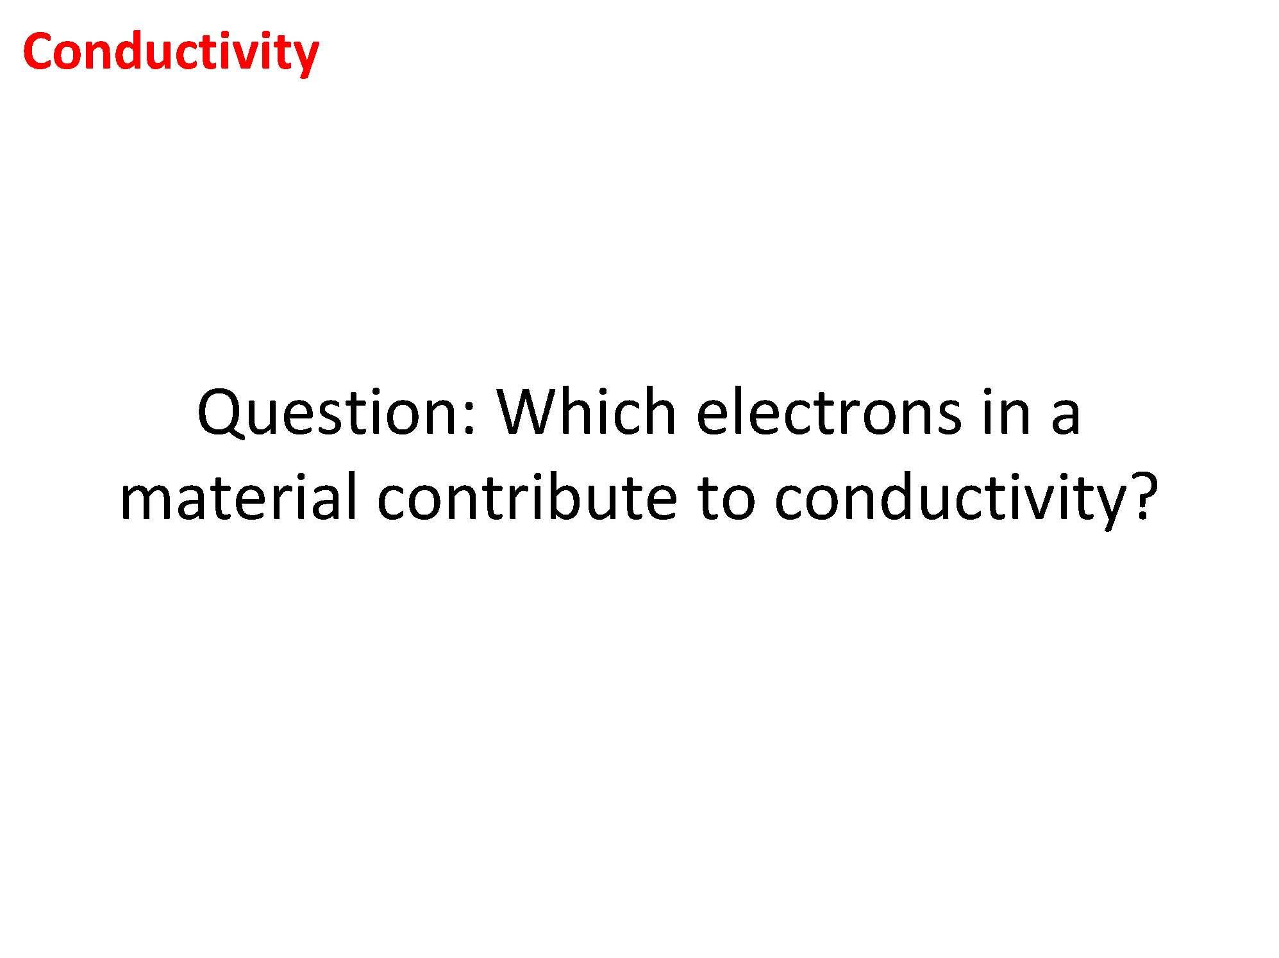

Slide 16
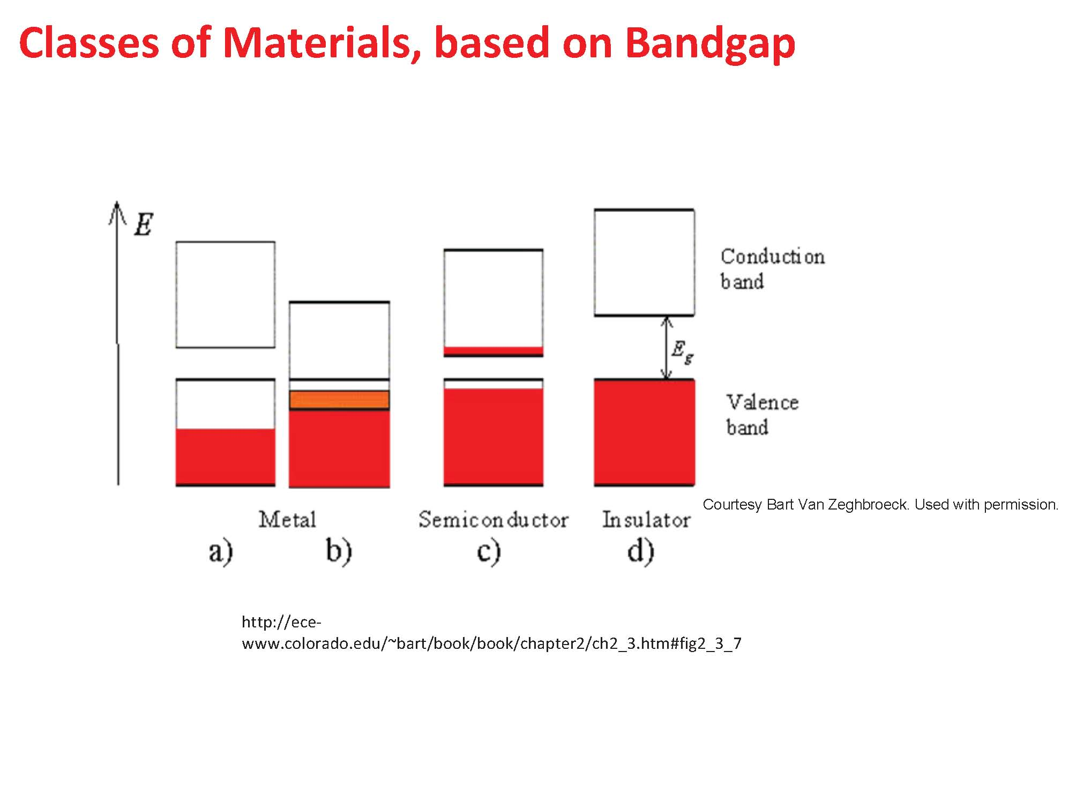

Slide 17
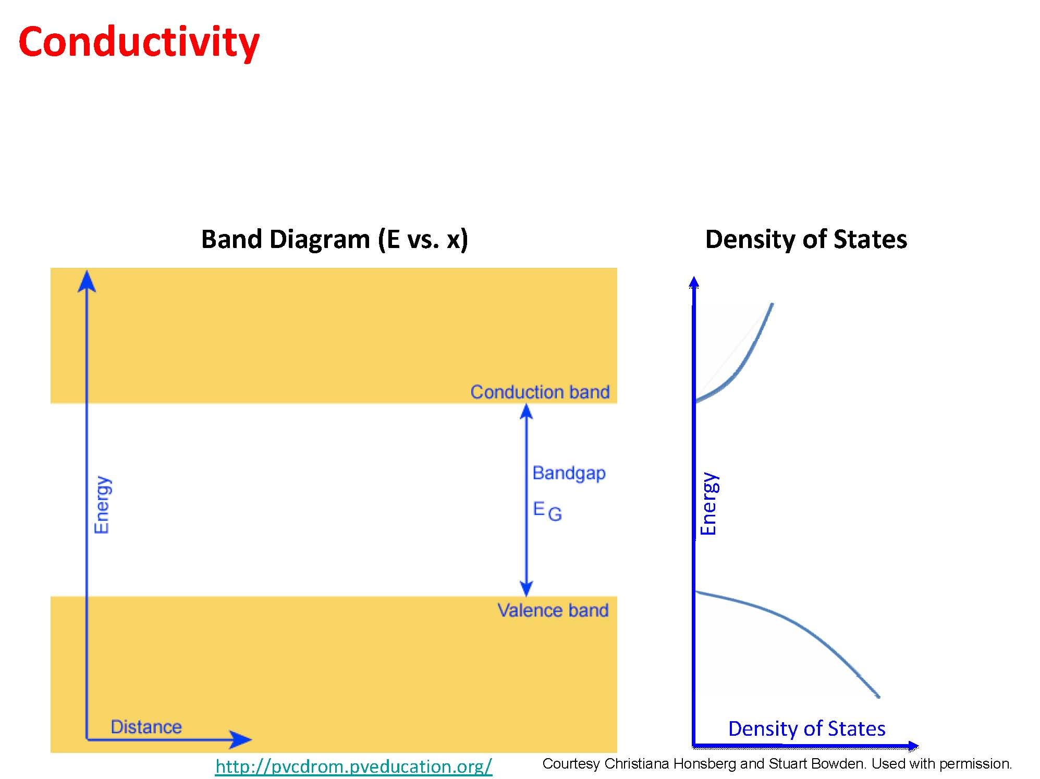

Slide 18
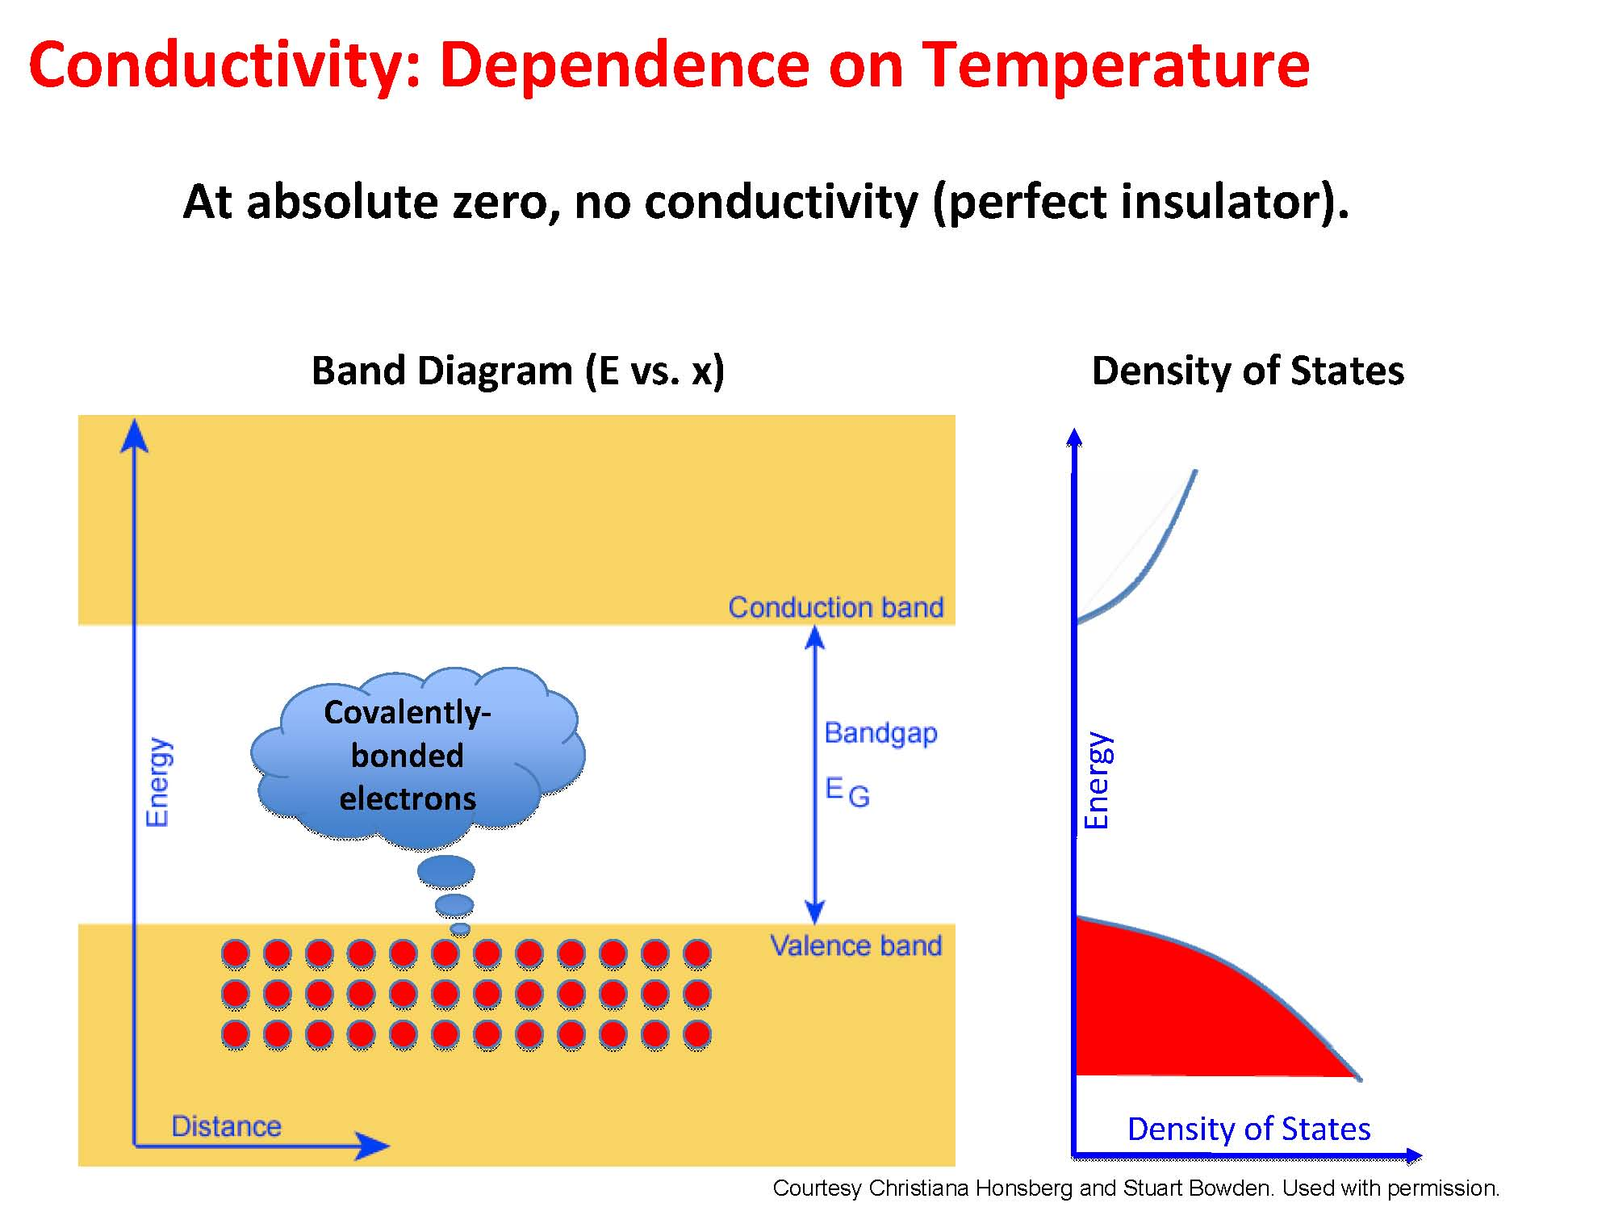

Slide 19
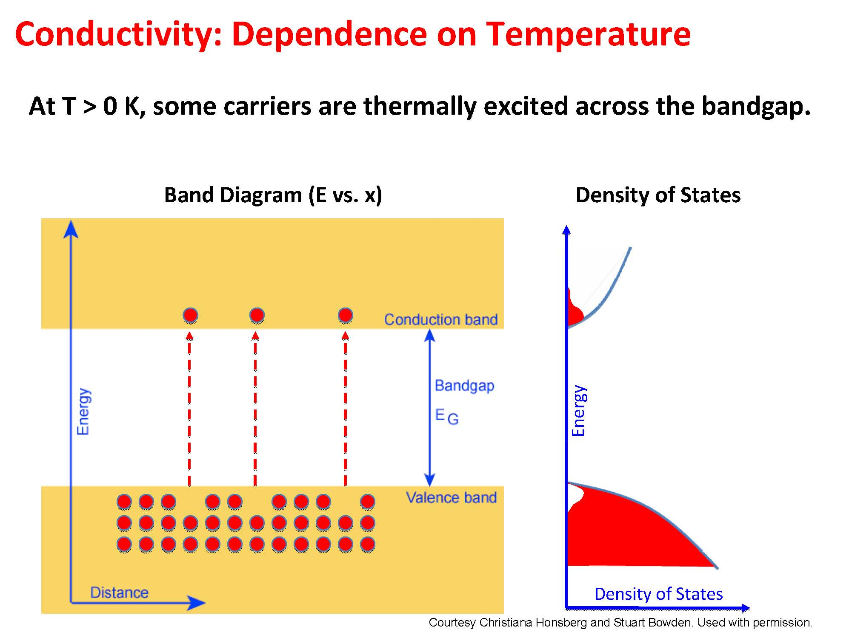

Slide 20
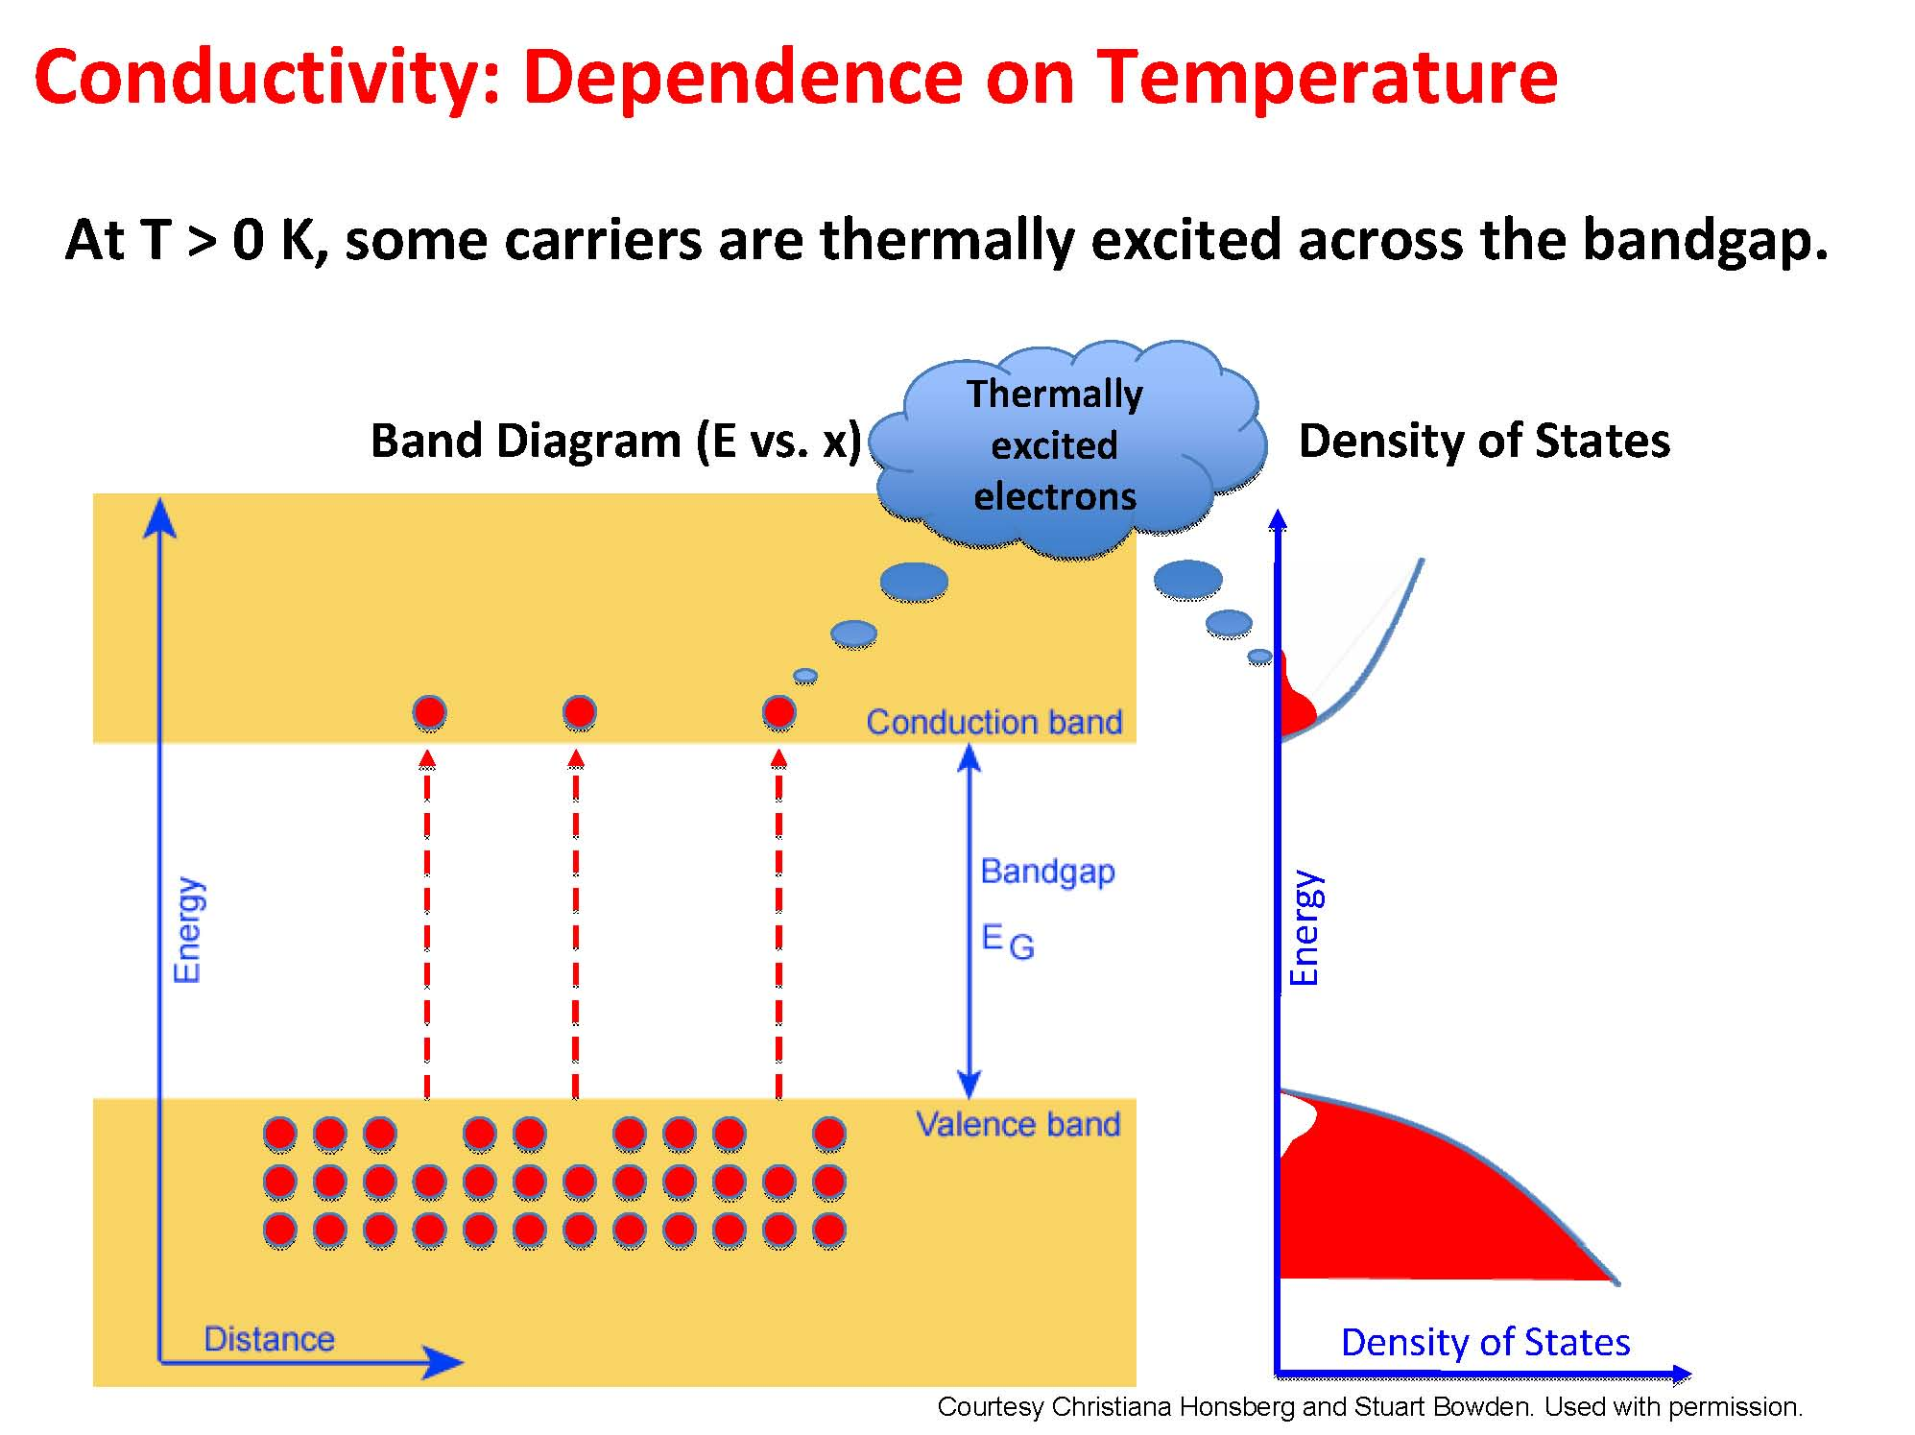

Slide 21


Slide 22
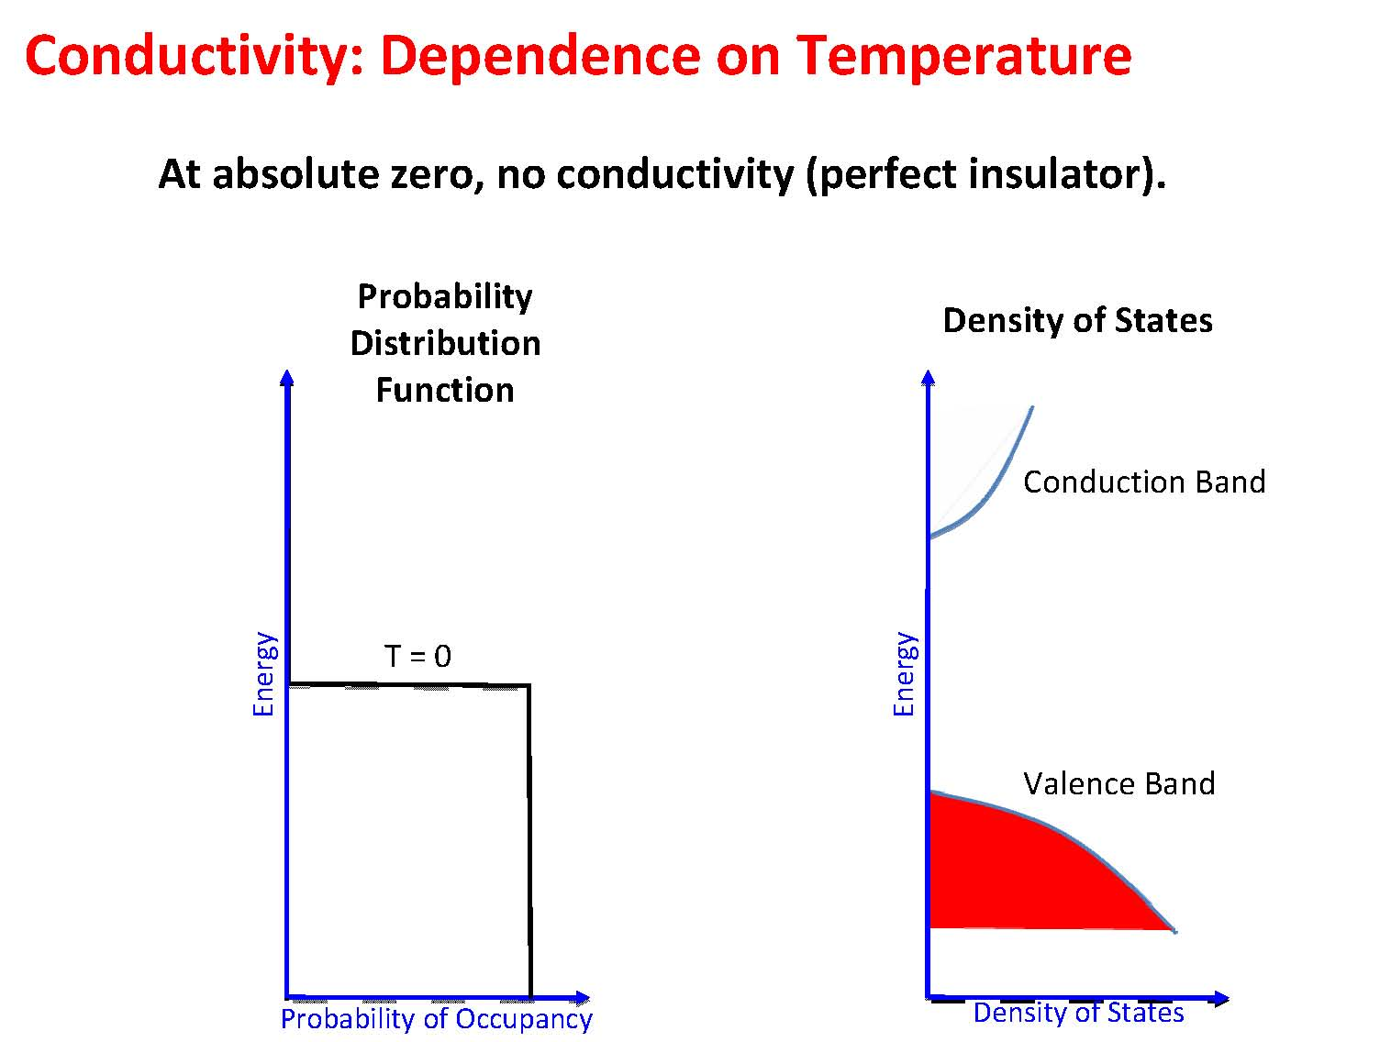

Slide 23
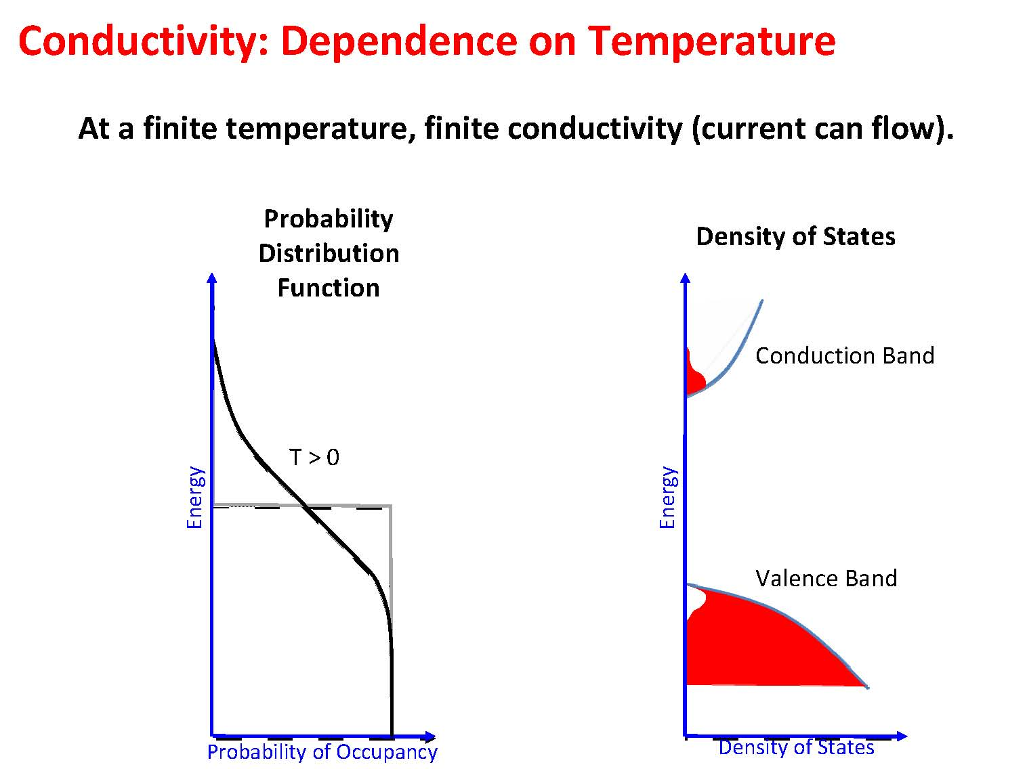

Slide 24
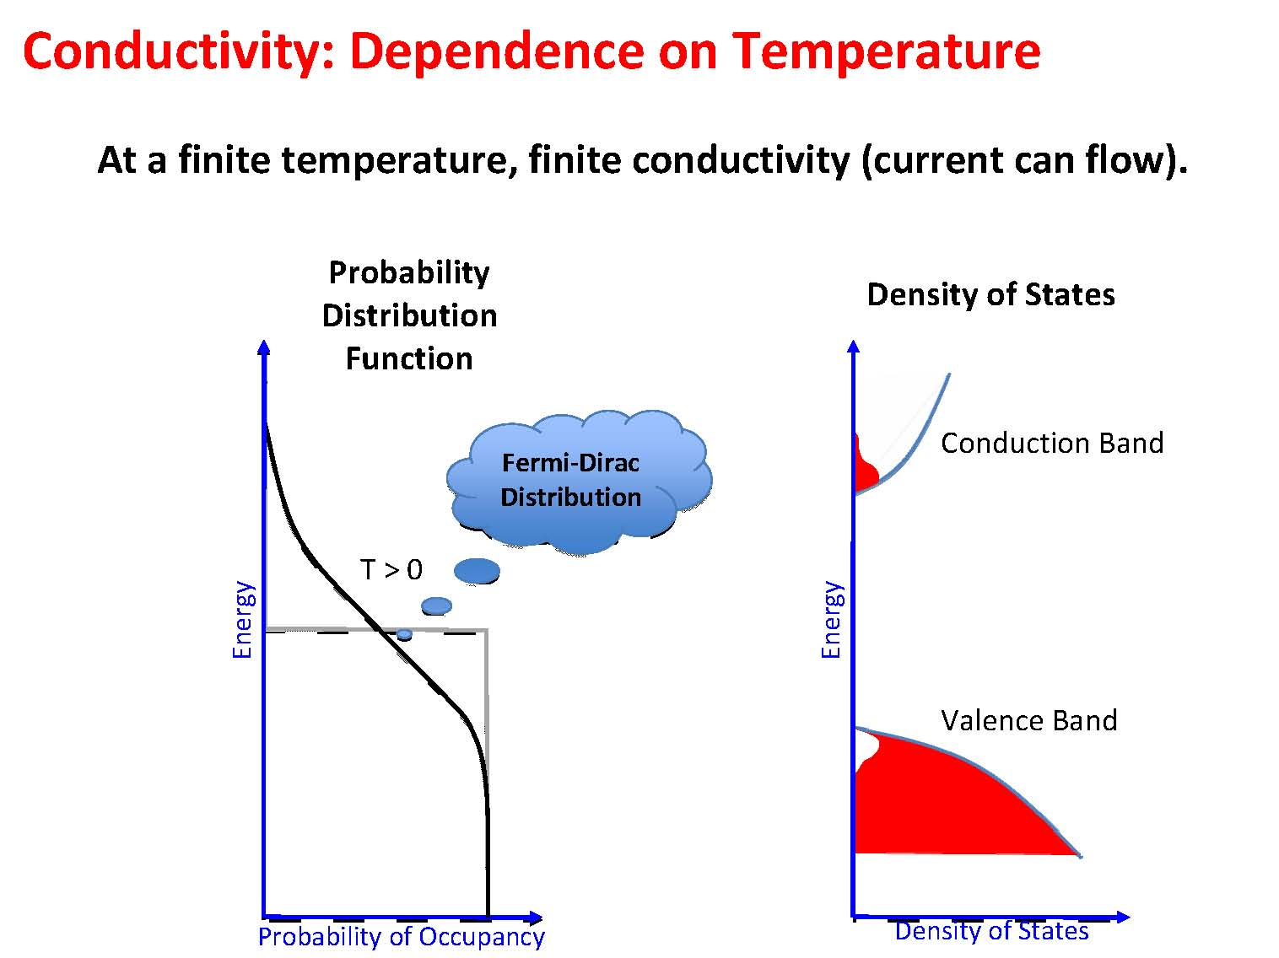

Slide 25
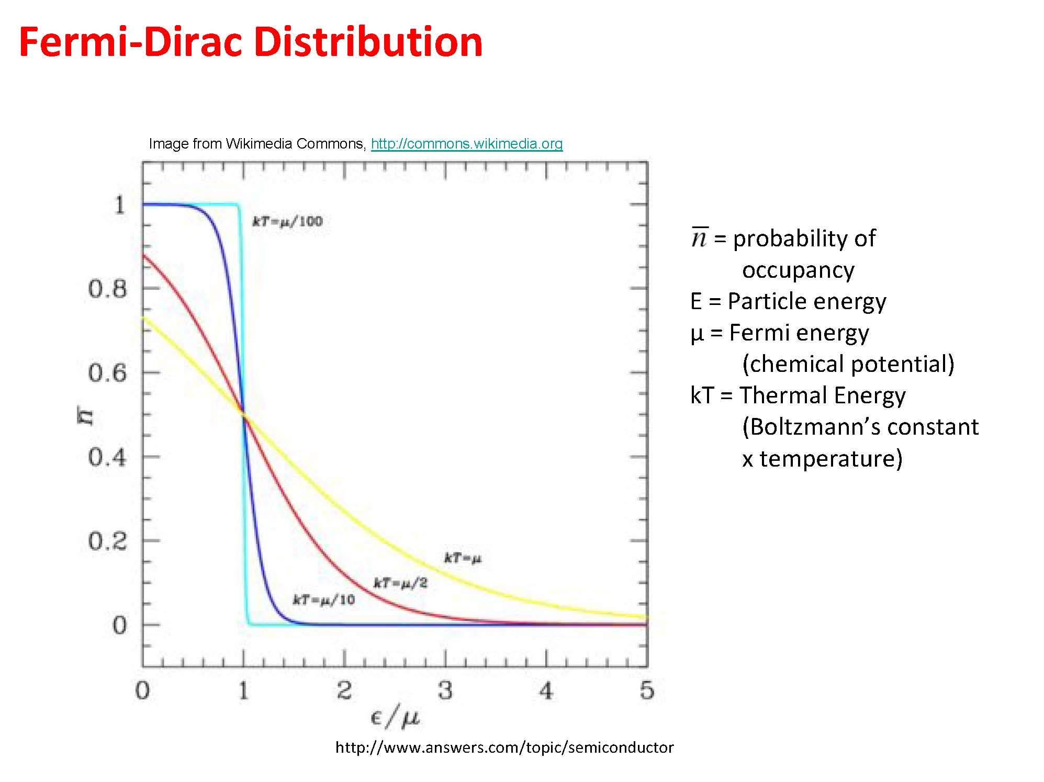

Slide 26
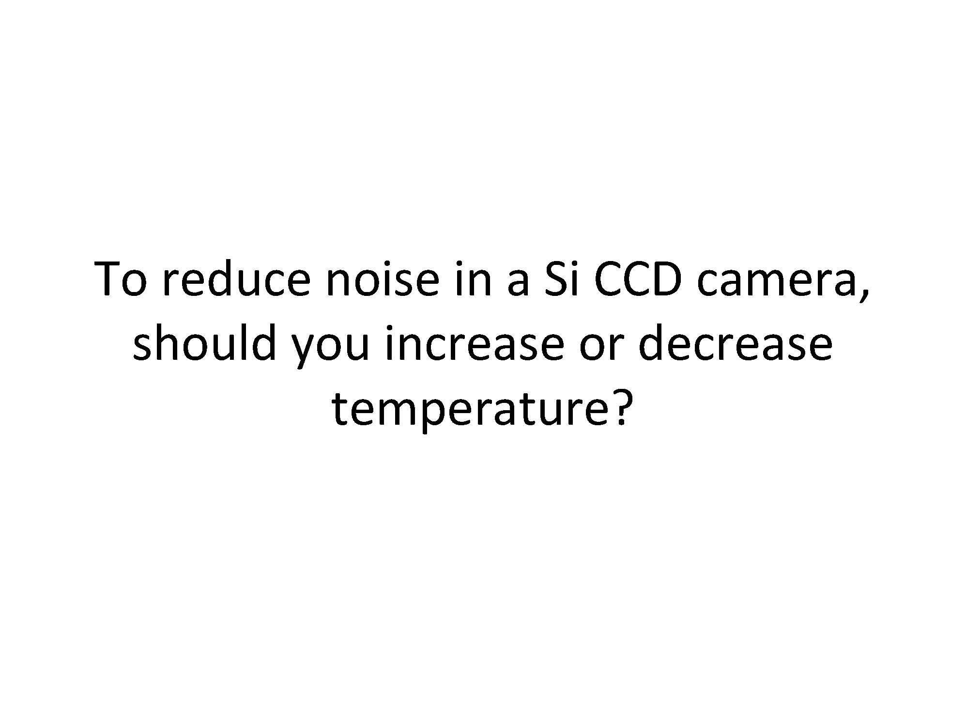

Slide 27
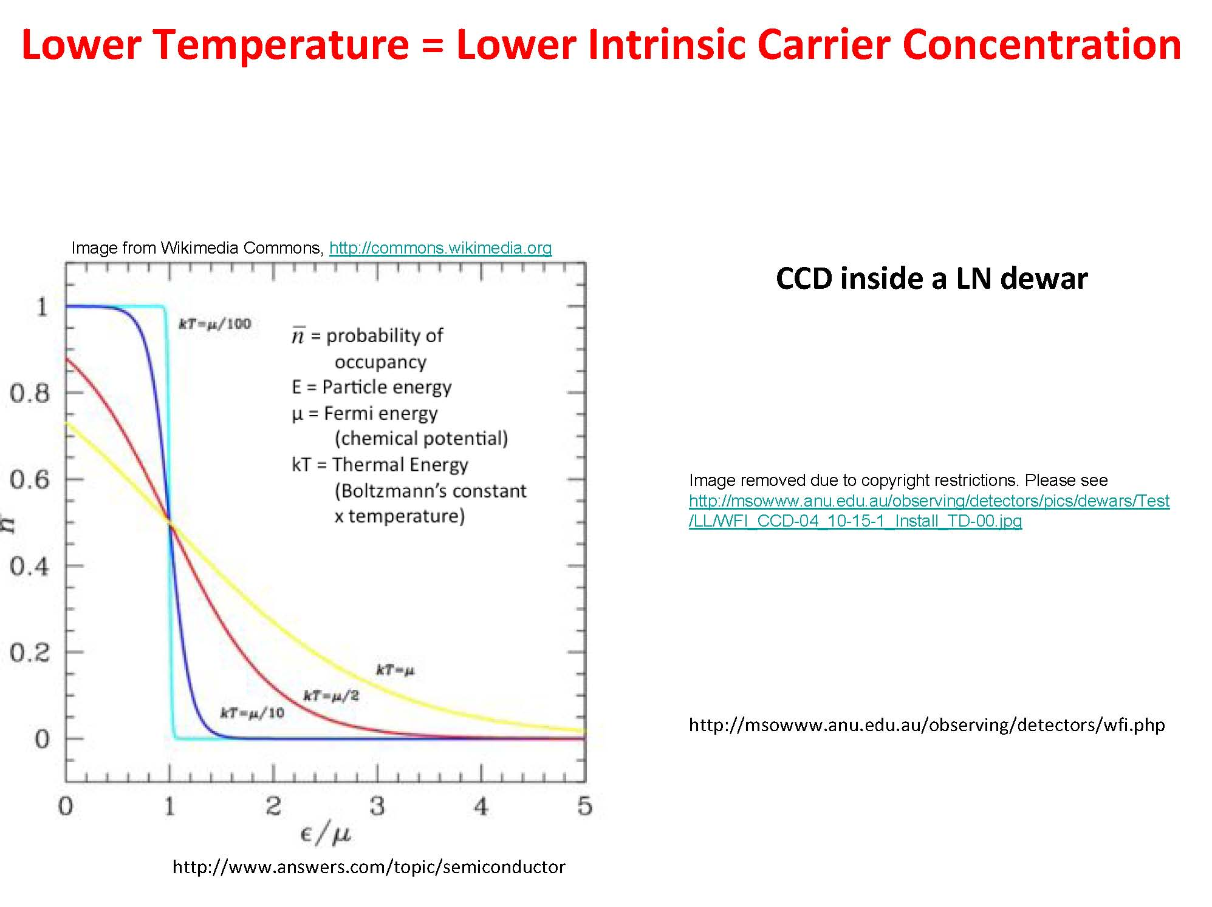
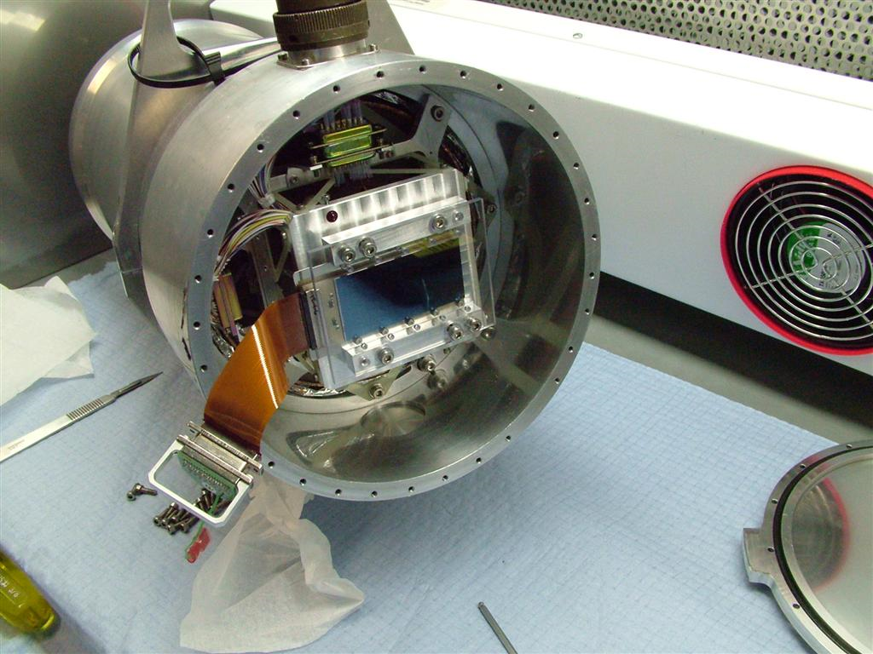

Slide 28
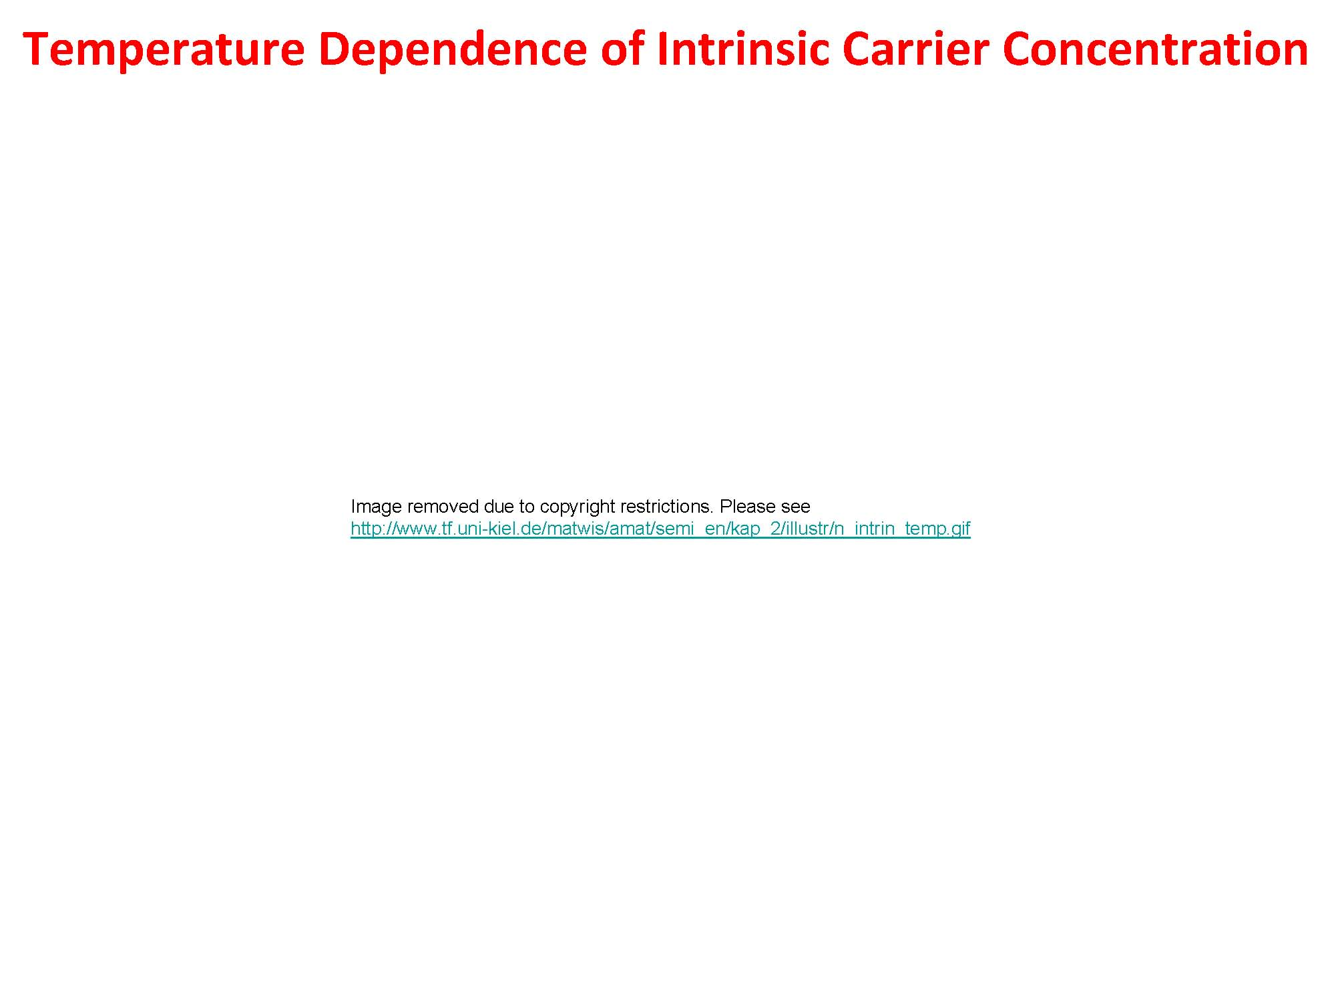
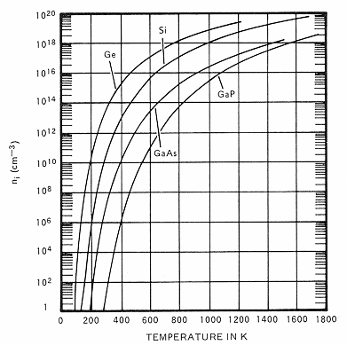


Slide 29
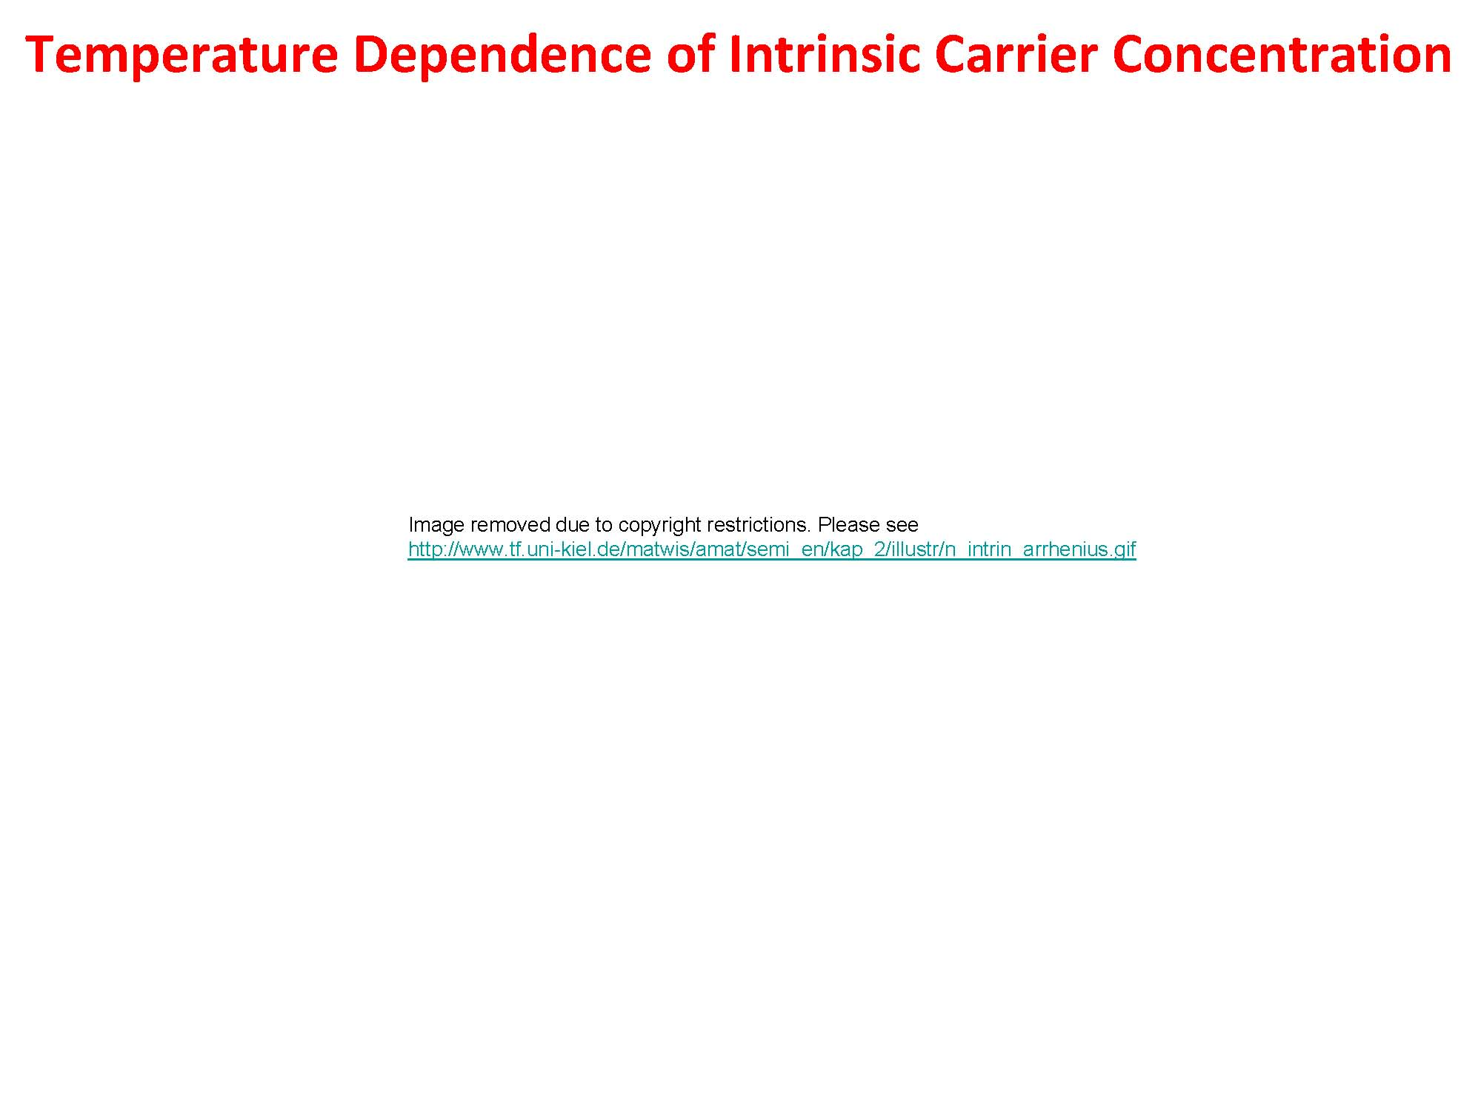
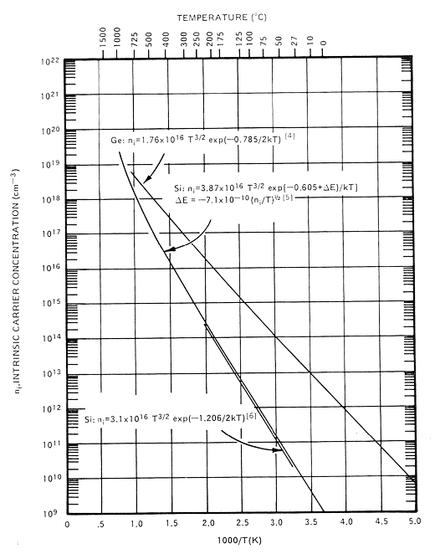

Slide 30
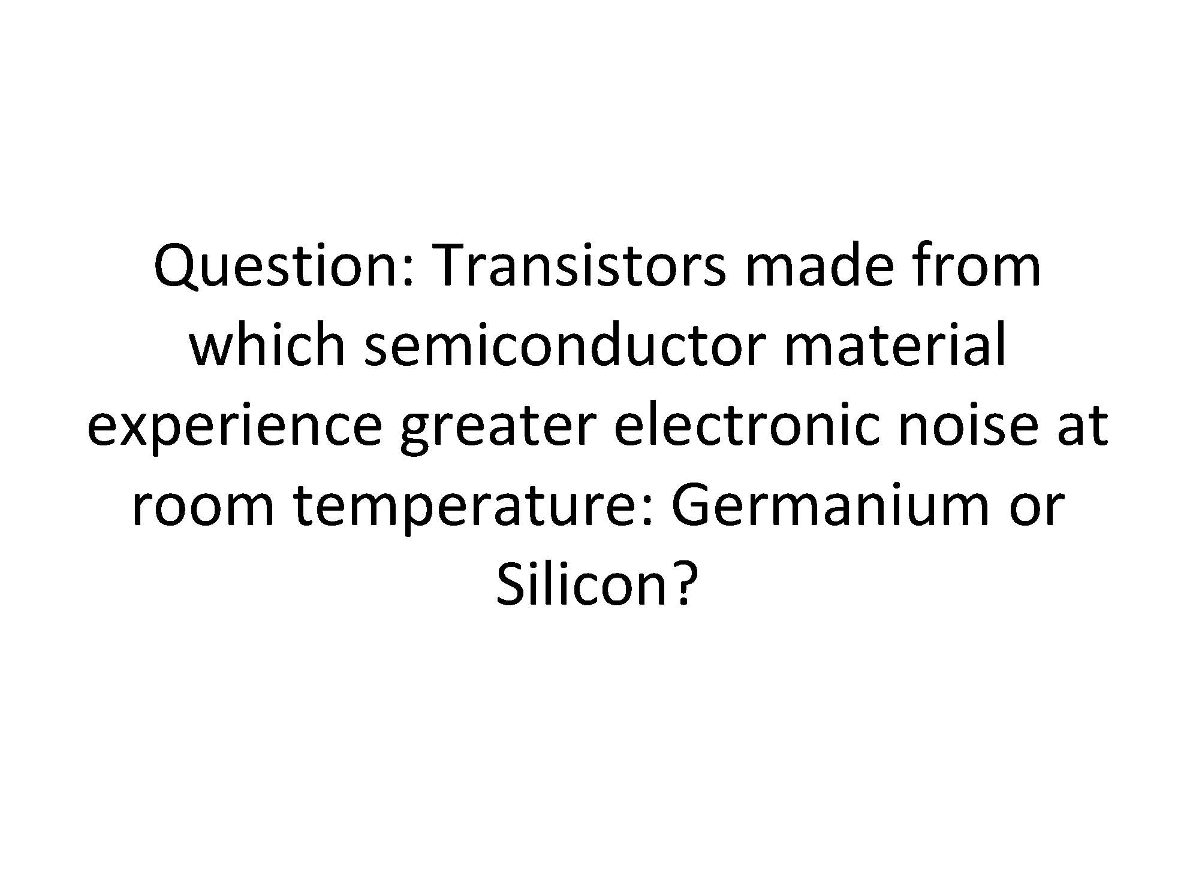

Slide 31
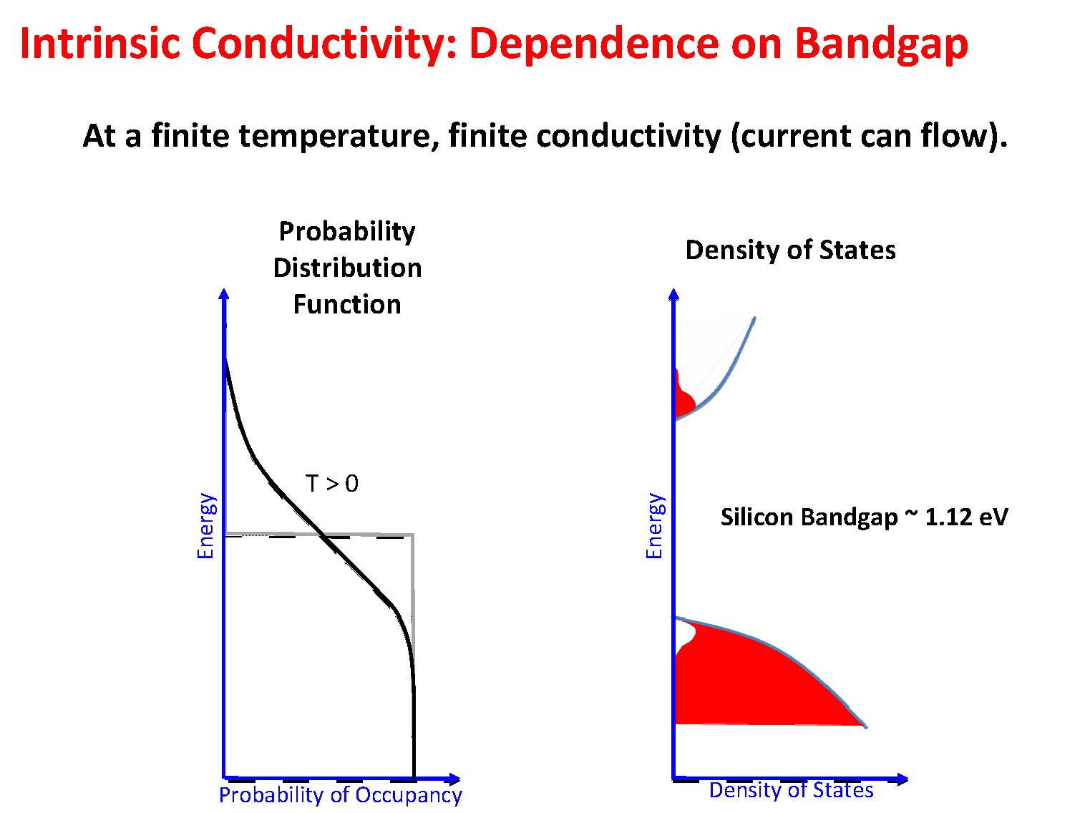

Slide 32
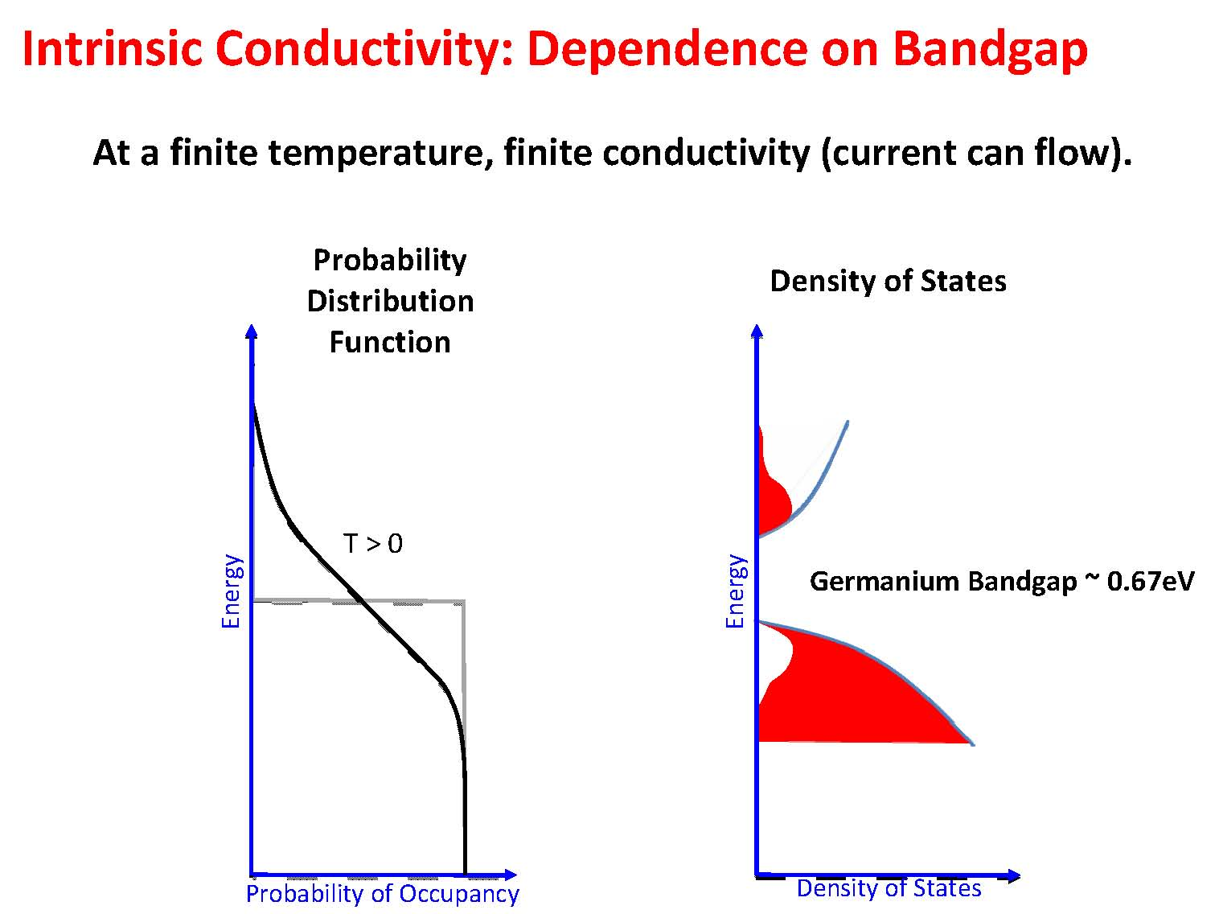

Slide 33
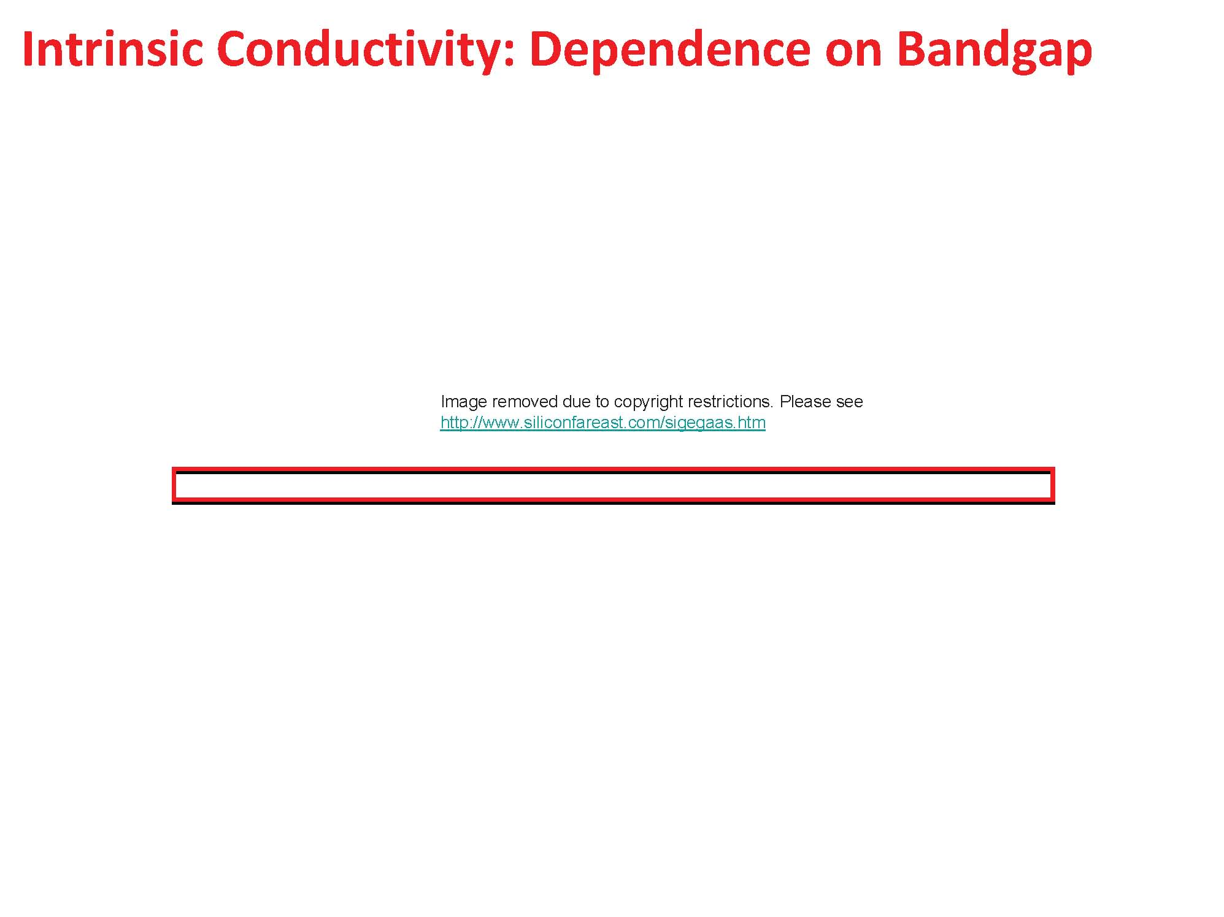
Properties | Si | Ge | GaAs
Atoms/cm³ | 5.0 x 10²² | 4.42 x 10²² | 4.42 x 10²²
Atomic Weight | 28.09 | 72.60 | 144.63
Breakdown Field | approx. 3 x 10⁵ | approx. 1 x 10⁵ | approx. 4 x 10⁵
Crystal Structure | Diamond | Diamond | Zincblende
Density (g/cm³) | 2.328 | 5.3267 | 5.32
Dielectric Constant | 11.9 | 16.0 | 13.1
Effective Density of States in the Conduction Band, Nc (cm⁻³) | 2.8 x 10¹⁹ | 1.04 x 10¹⁹ | 4.7 x 10¹⁷
Effective Density of States in the Valence Band, Nv (cm⁻³) | 1.04 x 10¹⁹ | 6.0 x 10¹⁸ | 7.0 x 10¹⁸
Electron Affinity (V) | 4.05 | 4.0 | 4.07
Energy Gap at 300K (eV) | 1.12 | 0.66 | 1.424
Intrinsic Carrier Concentration (cm⁻³) | 1.45 x 10¹⁰ | 2.4 x 10¹³ | 1.79 x 10⁶
Intrinsic Debye Length (microns) | 24 | 0.68 | 2250
Intrinsic Resistivity (ohm-cm) | 2.3 x 10⁵ | 47 | 10⁸
Lattice Constant (angstroms) | 5.43095 | 5.64613 | 5.6533
Linear Coefficient of Thermal Expansion, ΔL/L/ΔT (1/deg C) | 2.6 x 10⁻⁶ | 5.8 x 10⁻⁶ | 6.86 x 10⁻⁶
Melting Point (deg C) | 1415 | 937 | 1238
Minority Carrier Lifetime (s) | 2.5 x 10⁻³ | approx. 10⁻³ | approx. 10⁻⁸
Mobility (Drift) (cm²/V-s) µ_{n}, electrons | 1500 | 3900 | 8500
Mobility (Drift) (cm²/V-s) µ_{p}, holes | 475 | 1900 | 400
Optical Phonon Energy (eV) | 0.063 | 0.037 | 0.035
Phonon Mean Free Path (angstroms) | 76 (electron) 55 (hole) | 105 | 58
Specific Heat (J/g-deg C) | 0.7 | 0.31 | 0.35
Thermal Conductivity at 300 K (W/cm-degC) | 1.5 | 0.6 | 0.46
Thermal Diffusivity (cm²/sec) | 0.9 | 0.36 | 0.24
Vapor Pressure (Pa) | 1 at 1650 deg C; 10⁻⁶ at 900 deg C | 1 at 1330 deg C; 10⁻⁶ at 760 deg C | 100 at 1050 deg C; 1 at 900 deg C

Slide 34
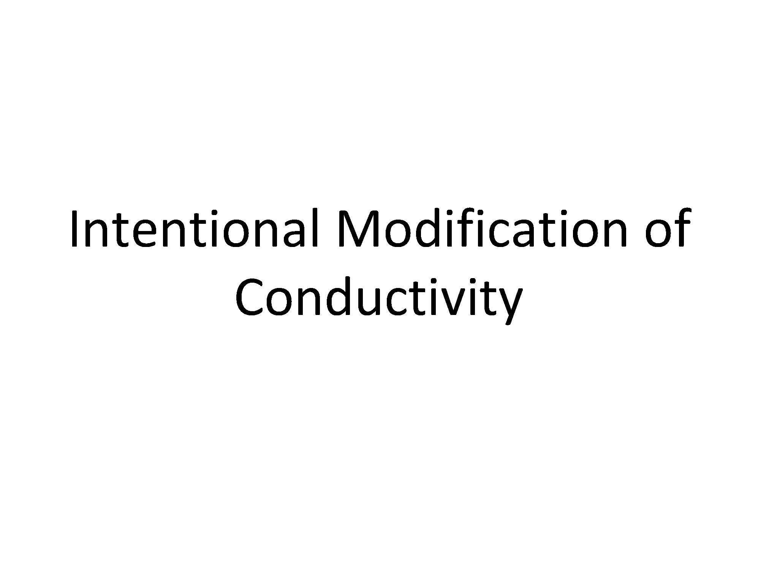

Slide 35
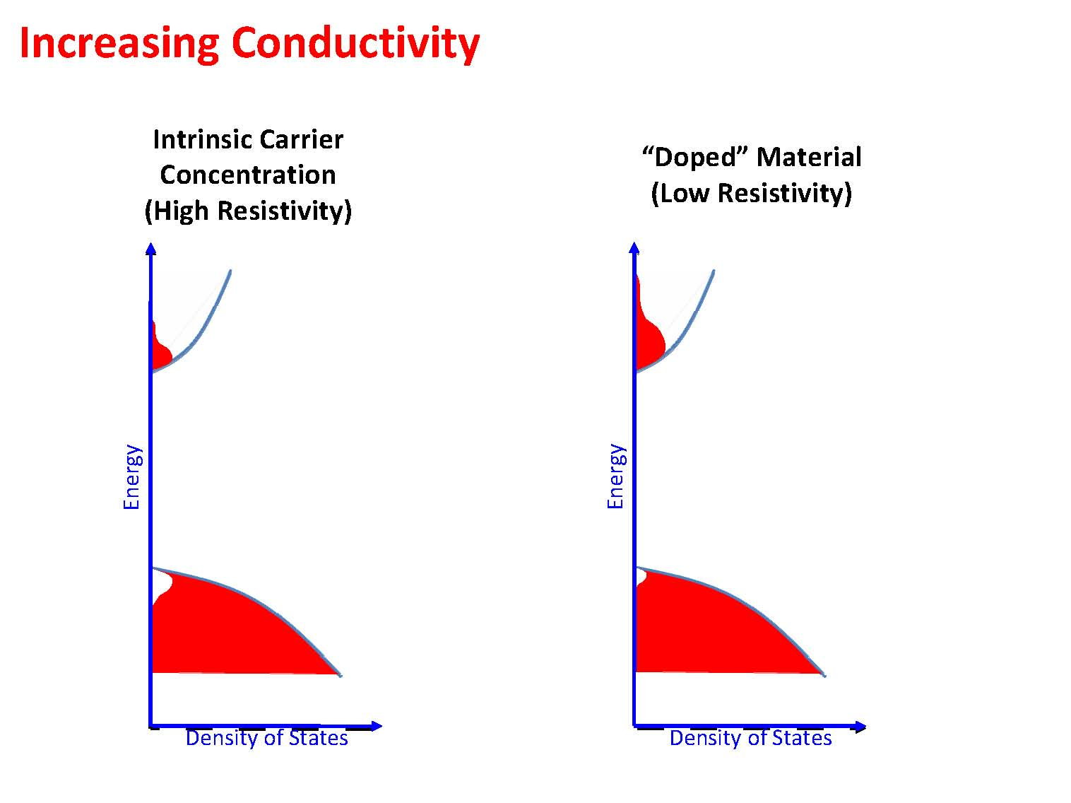

Slide 36
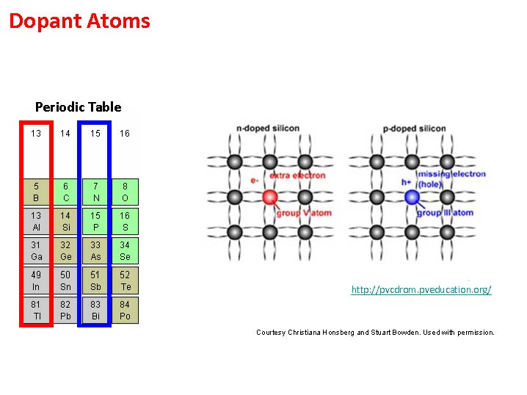

Slide 37
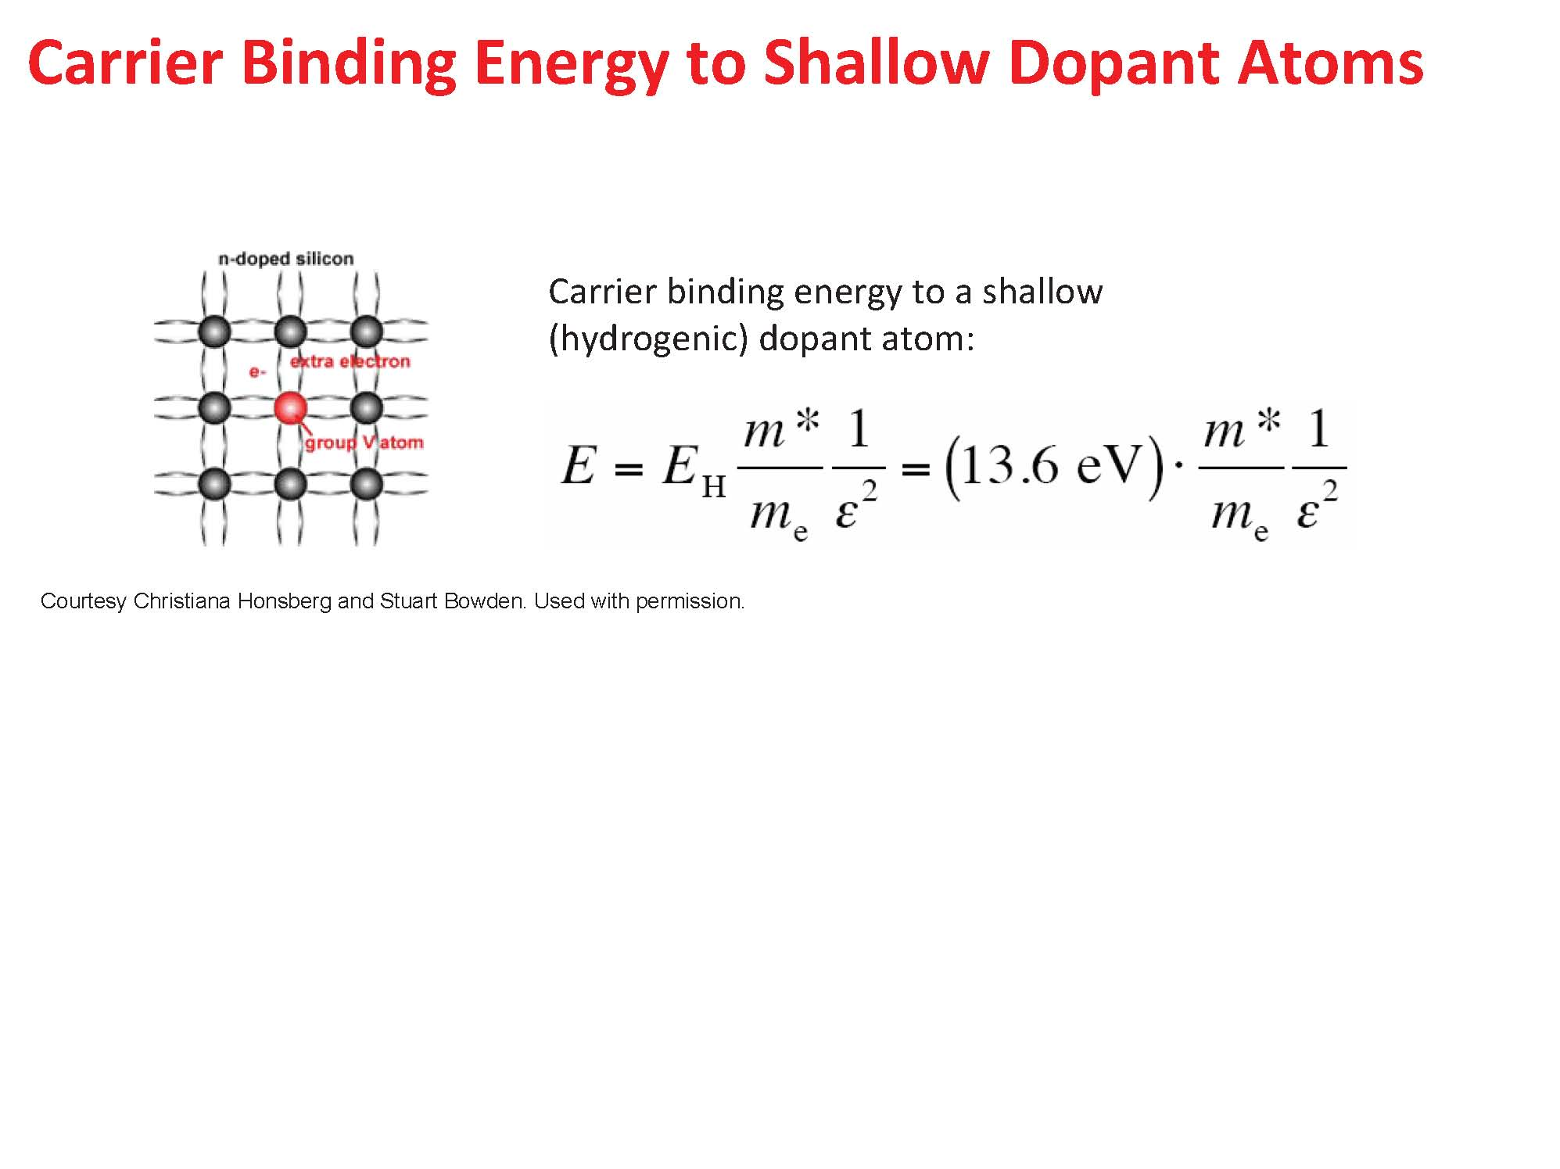

Slide 38
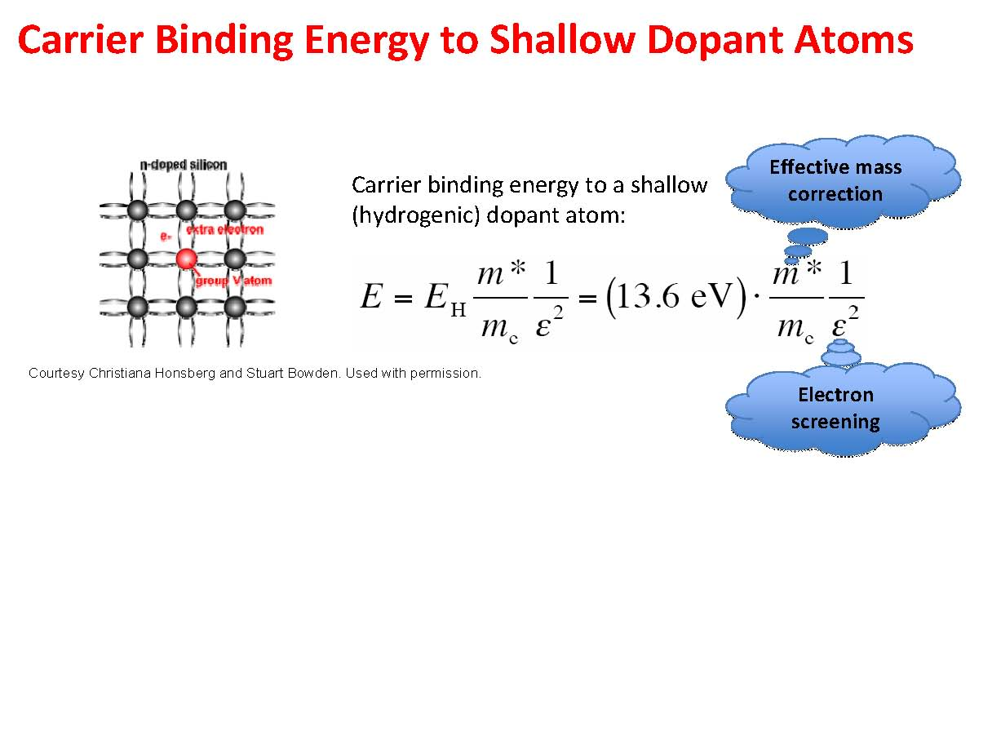

Slide 39
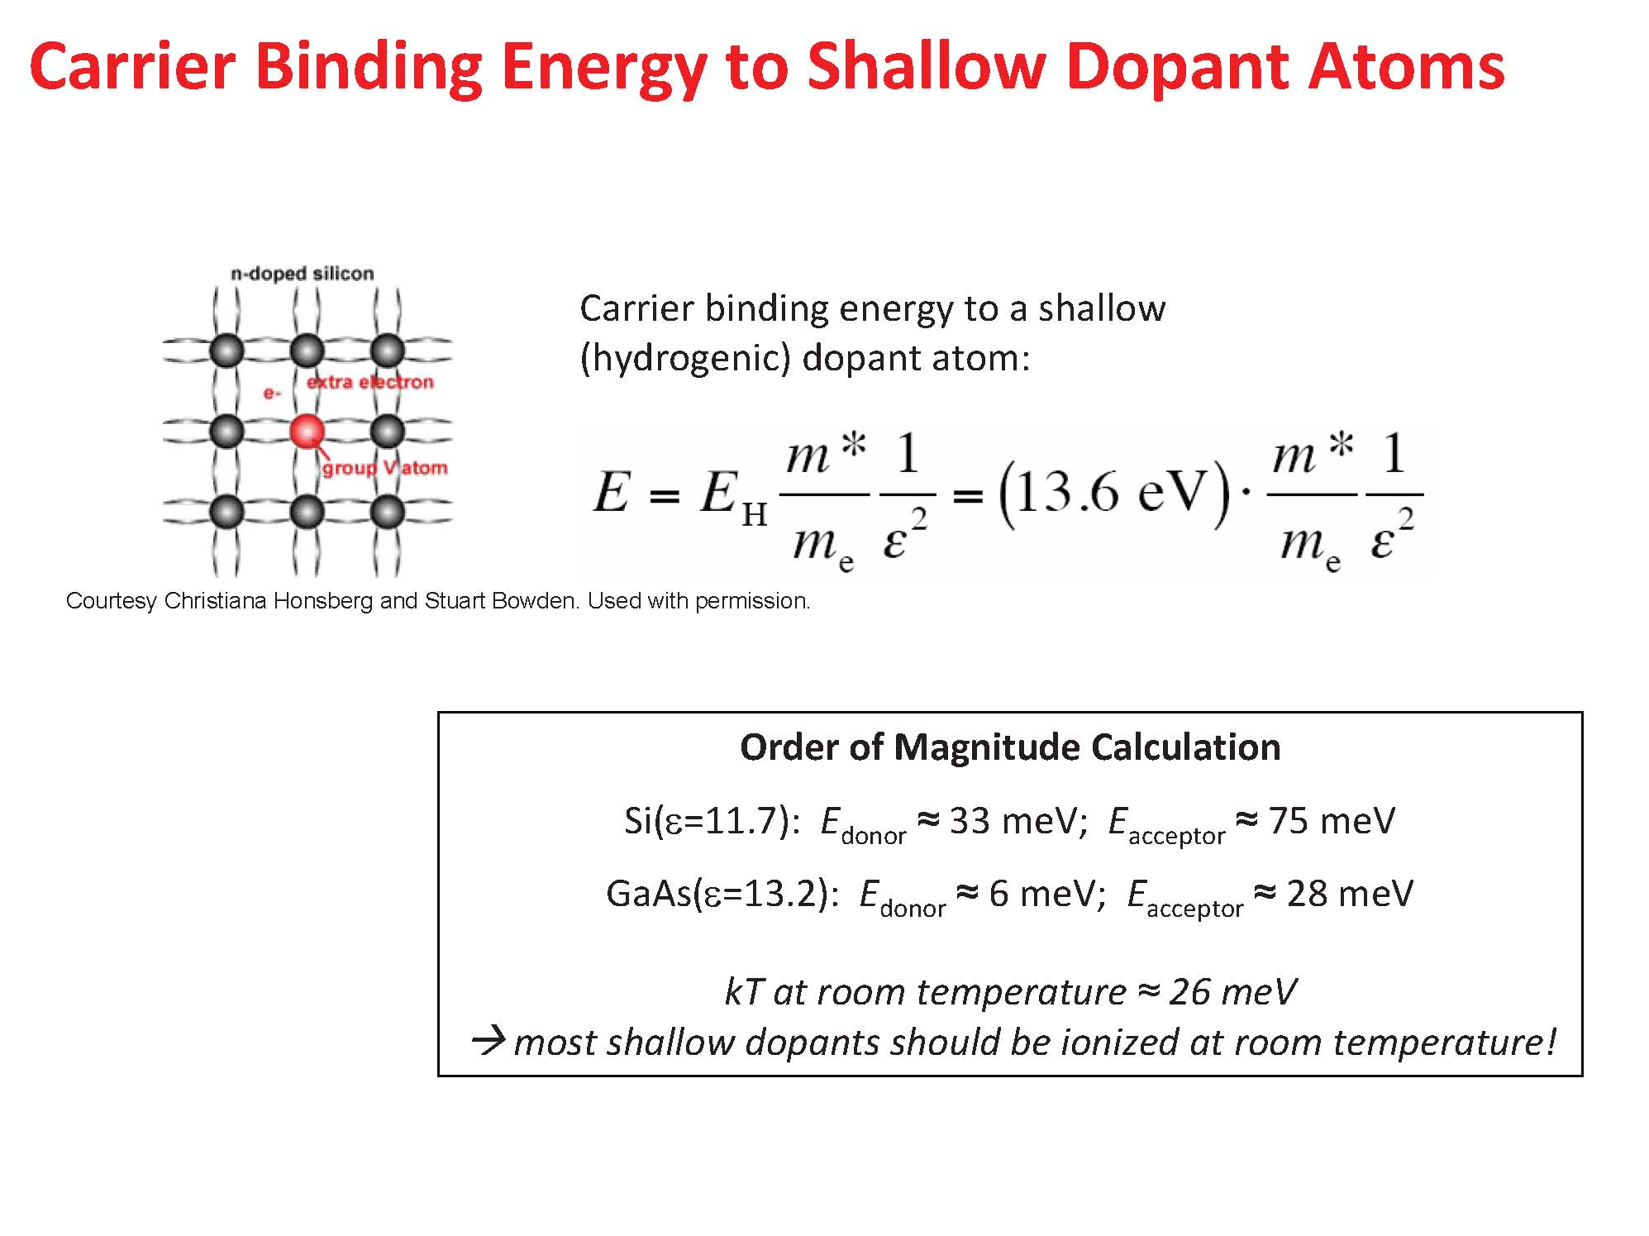

Slide 40
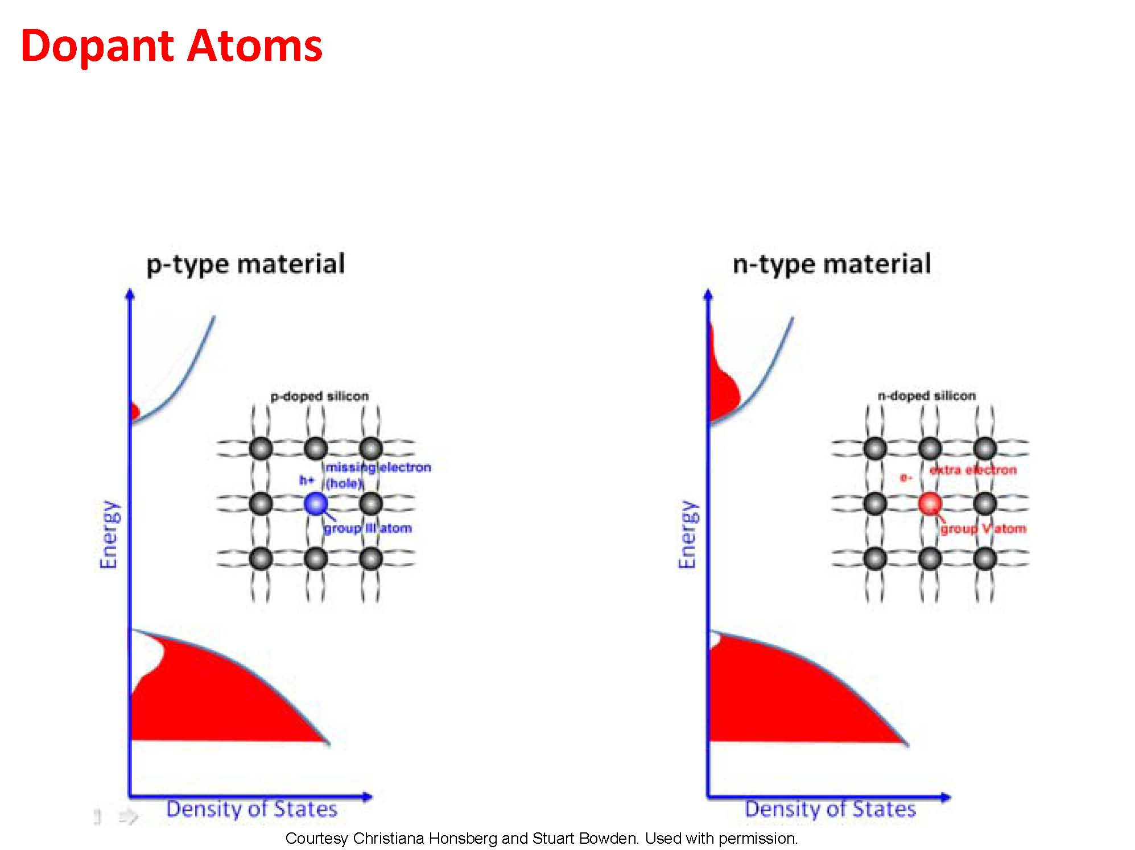

Slide 41
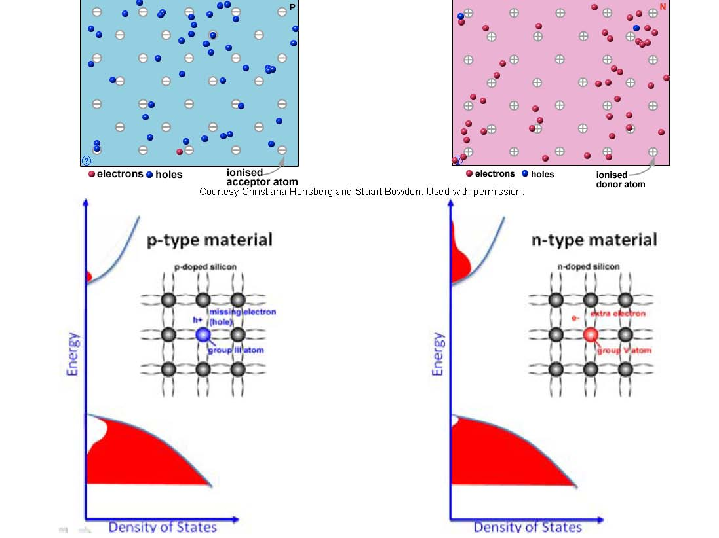

Slide 42
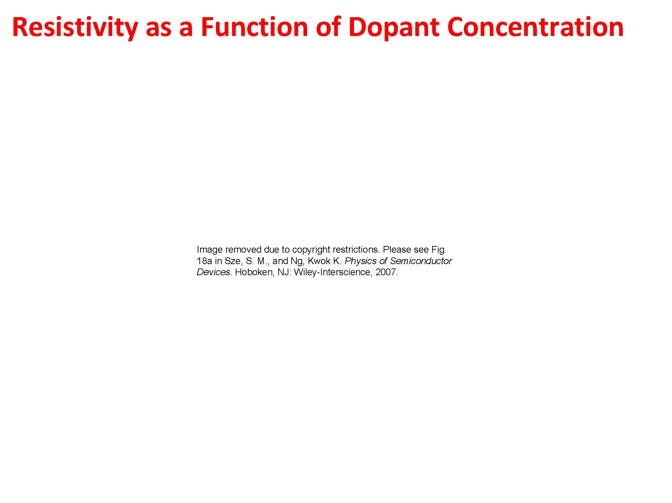

Slide 43
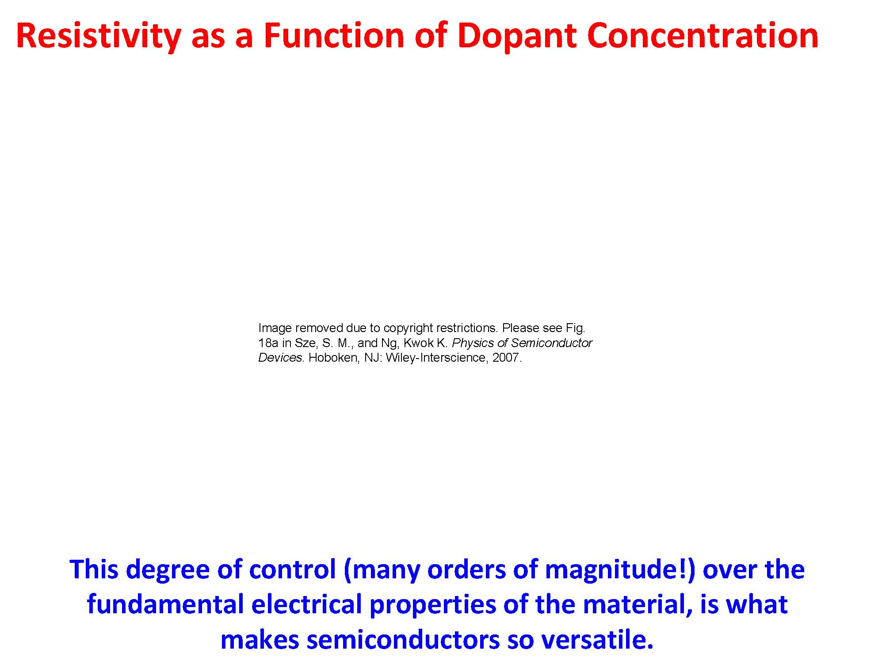
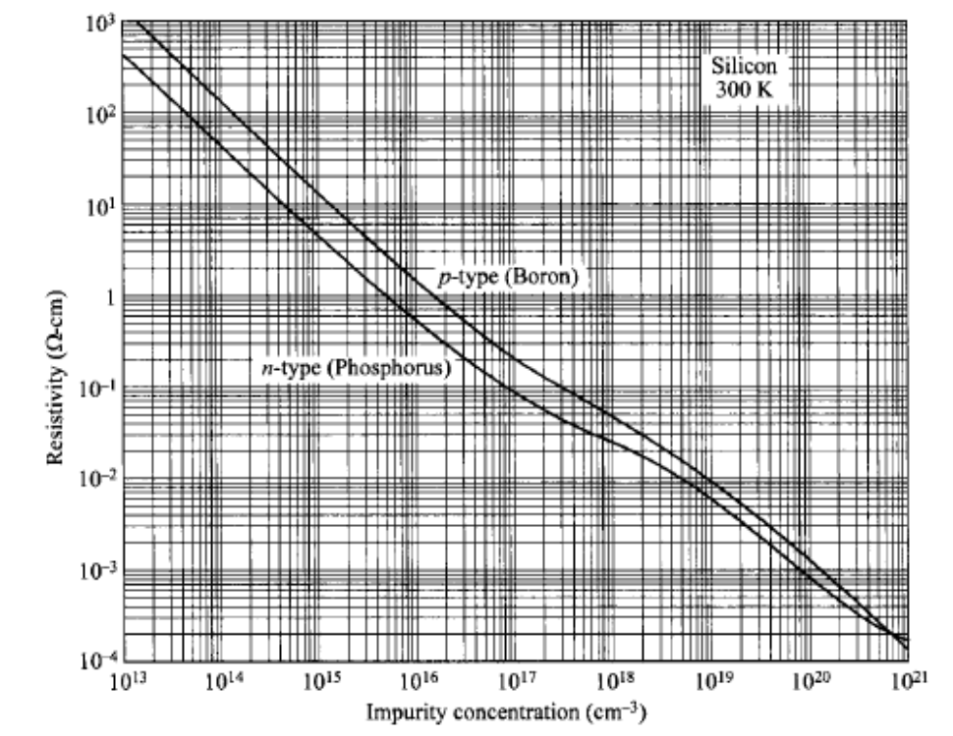

Slide 44
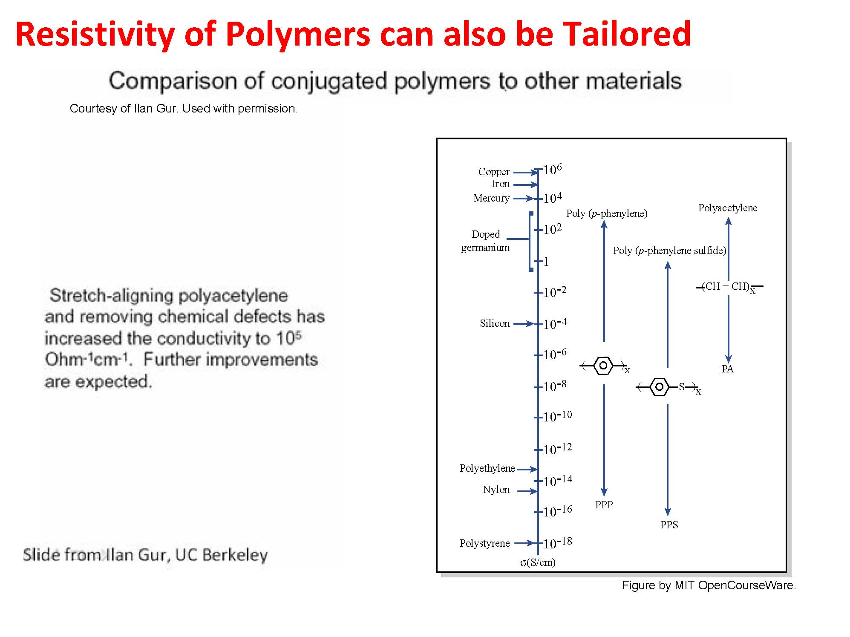

Slide 45
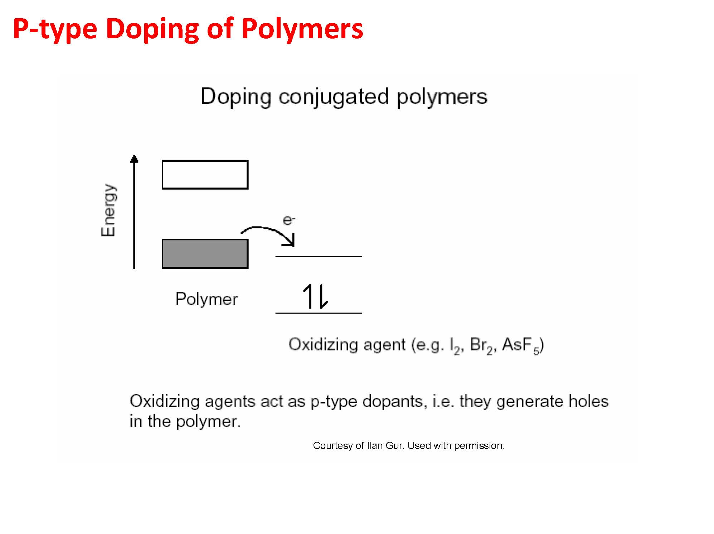

Slide 46
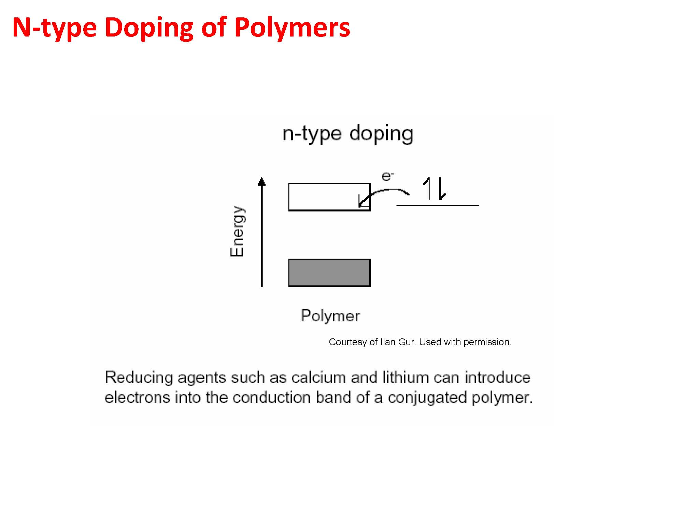

Slide 47
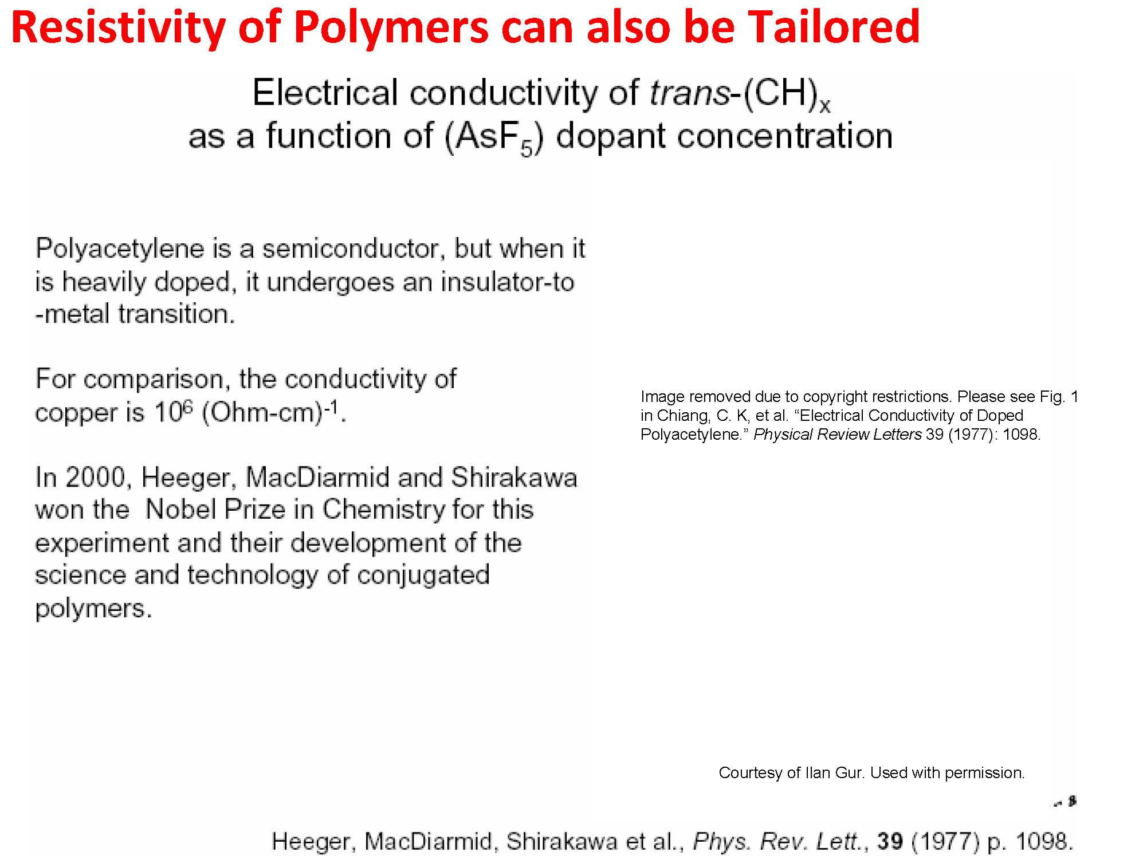
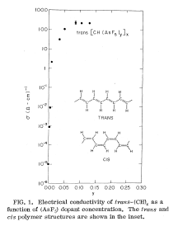

Slide 48
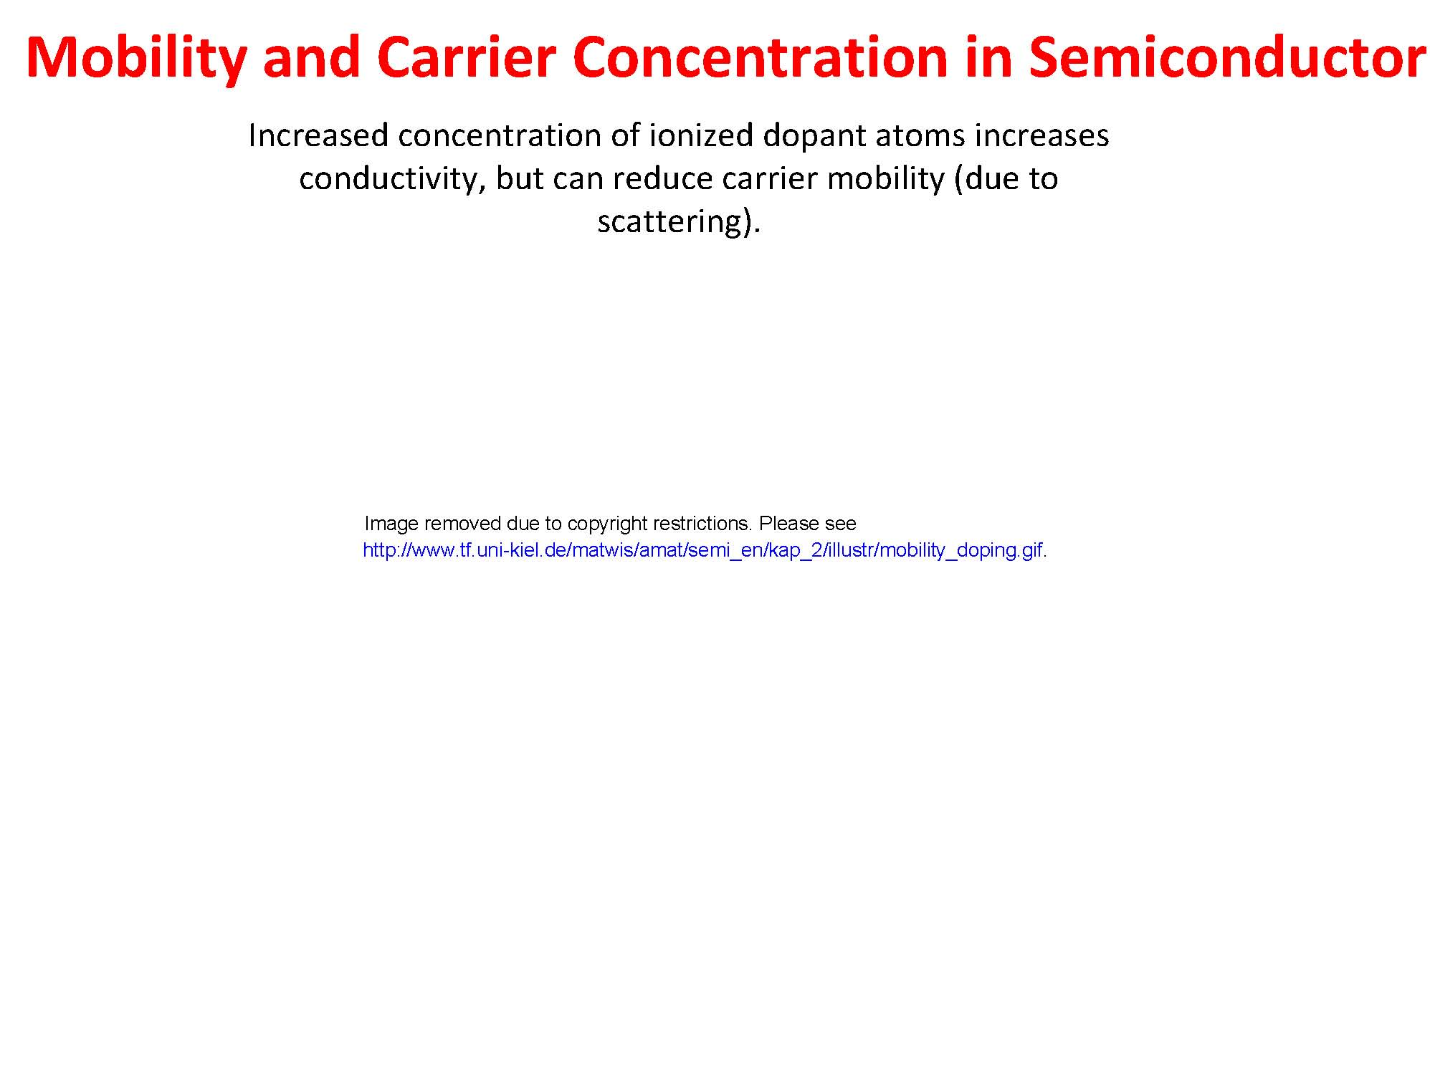


Slide 49


Slide 50



Slide 51


Slide 52


Slide 53


Slide 54


Slide 55


Slide 56


Slide 57


Slide 58


Slide 59


Slide 60




Slide 61




Slide 62



